Slide 1
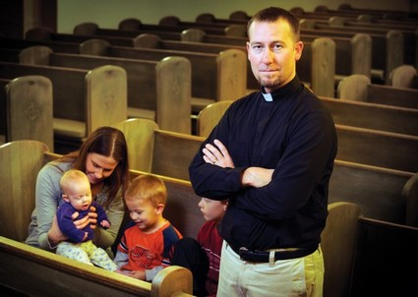
Sacerdos Filius Physicians Sons and Grandsons of Clergymen
Stephen I. Schabel M.D., FACR FCCP
September 2017

Slide 2
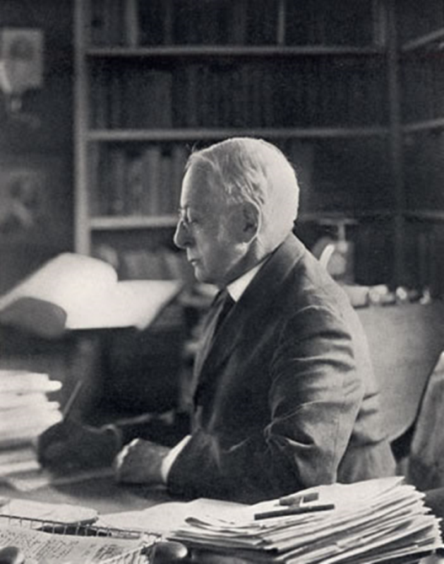
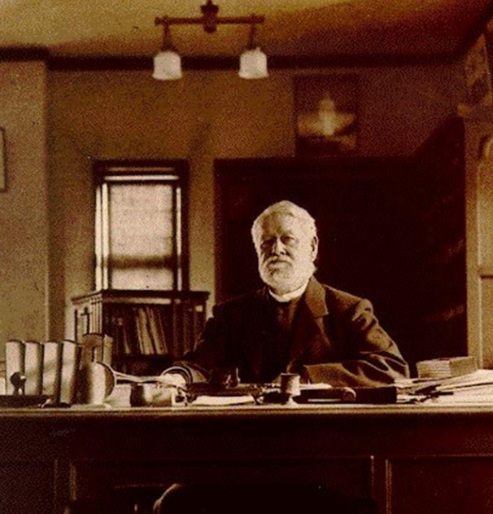
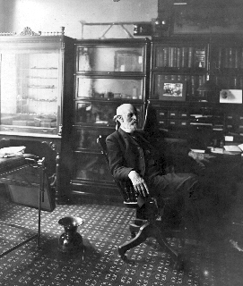
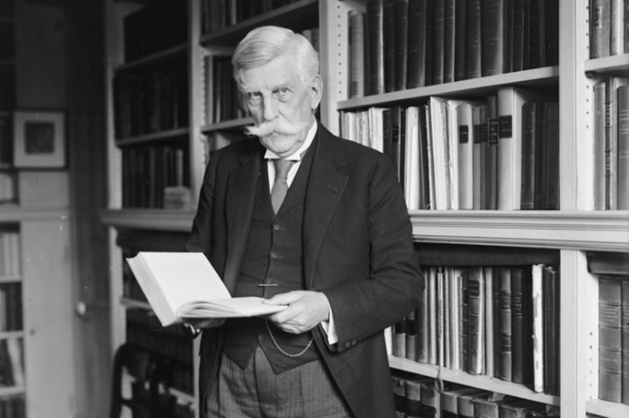
The 4 Noble (“Learned”) Professions
Dedicated to education of and/or service to fellow man
Higher Academia – Professor – Ph.D.
Law
Medicine
Clergy
BOOKS
Notes:
Charles elliot
Oliver wendel holmes
Physician alexander
Presbyterian minister

Slide 3
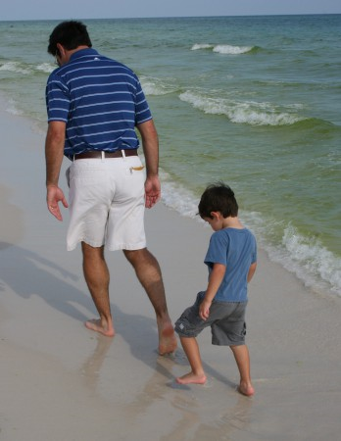
Sons Often Follow Fathers

Slide 4
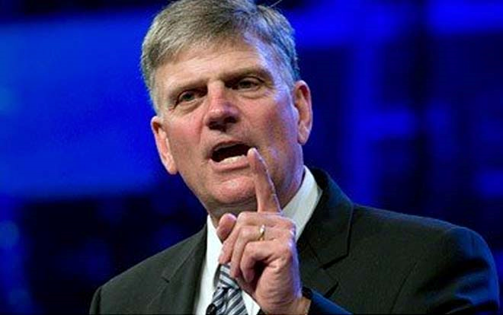
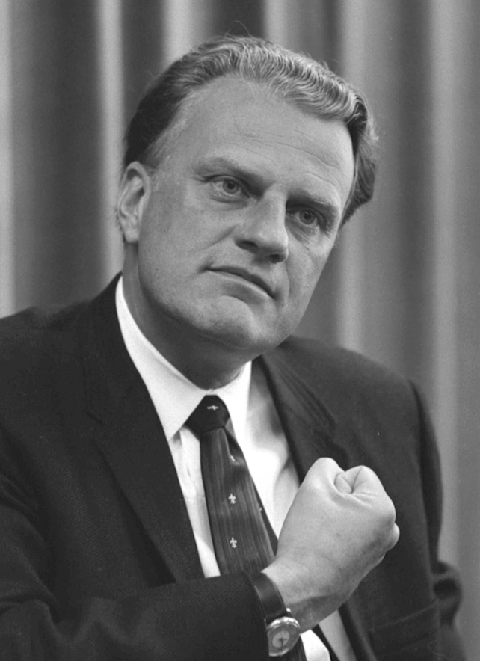
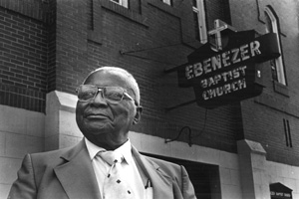
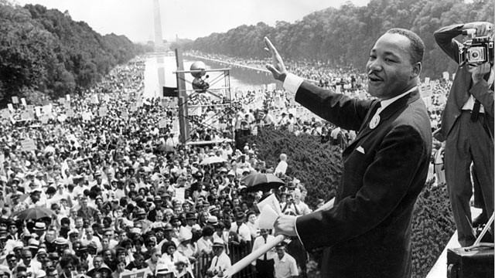
Franklin and Billy Graham
M.L. King Jr and M.L.King

Slide 5
A Different Path But a Good Path Father Clergy – Son Physician

Slide 6
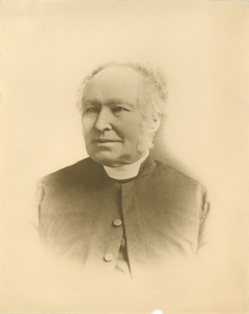
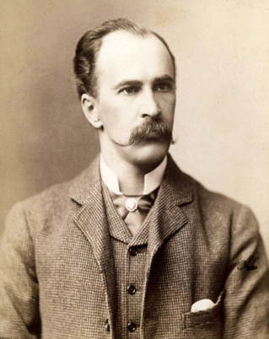
Reverend Featherstone Lake Osler
Featherstone Lake Osler - Cornish “Black Celts”- b. 1805 @ Falmouth son of Edward Osler surgeon , British Navy 5 years studied Anglican minister (Cambridge ,St. Catherine’s Hall 1833-1837 then emigrated to Bonds Head Ontario
Started 28 congregations and a lending library
William Osler M.D., youngest of 9 children b. 1849 @ Bonds Head parsonage
W.O. Went to University of Toronto in 1867 intending to study for clergy 1868 switched to Toronto school of medicine influenced by biology teacher and transferred to McGill M.D. 1872

Slide 7
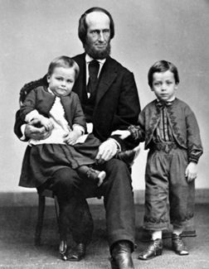
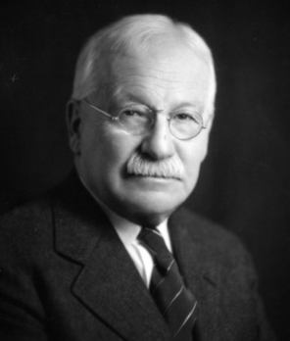
Reverend Ebenezer Dickey Finney
Ebenezer Dickey Finney Presbyterian minister from Maryland
Princeton Theological Seminary 1849
Assigned to Presbyterian Church in Greenwood , MS - lived in Natchez .
John Miller ( later Turpin) Finney b. 1863
A.B. Princeton 1884, Harvard M.D. 1889
Played football at both Princeton and Harvard
Intern and resident MGH
William S. Thayer M.D. Medical school friend recommended him to Halsted
Opening day of J.H.H. 1889 W.S.H. hired him to be Surgeon for clinic J.H.H.
First President American College of Surgeons 1913 (X2)
Pyloroplasty 1902
Son JMTF Jr., Princeton 1915 ,M.D. J.H.M.S. 1919, V.P. Southern Surgical 1943, son George also M.D. and grandson William Finney M.D. J.H.M.S. 1953 surgeon
William

Slide 8
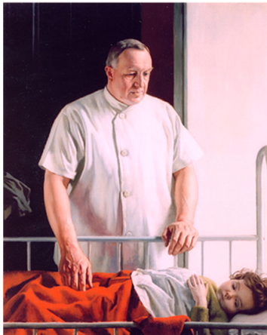
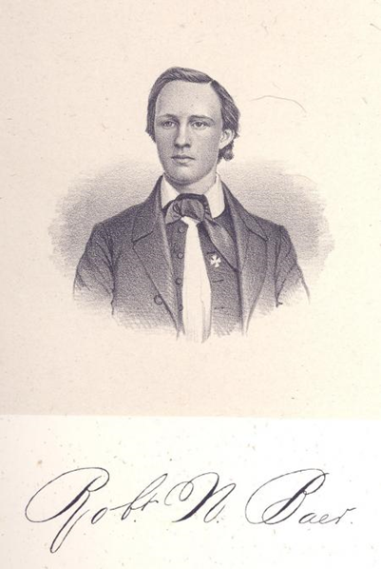
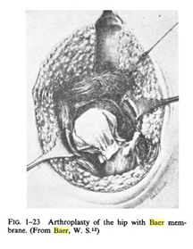
Reverend Robert Newton Baer
Born 1834, Dickinson College Carlisle PA. 1858 , Methodist Episcopal minister –Fayette St Methodist Church Baltimore died of typhoid 1888 @ age 54
Son William Stephenson Baer–M.D. J.H.M.S. 1898 - surgery resident with W.S.H. -1900 Orthopedics – summer Boston– Partner of Frederick Henry Baetjer M.D.
1931 maggot therapy
1919 Baer membrane arthroplasty

Slide 9
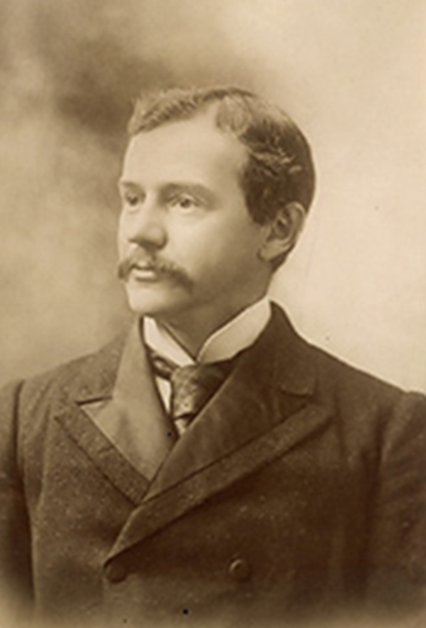
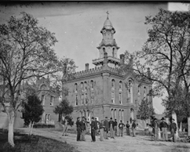
Reverend Anson Bois Hard
Episcopal minister –Middlebury College 1822 - Alexandria Theological Seminary VA. 1829
Daughter Louisa W. Hard married Henry Kuhl Kelly ( sugar broker) Both very religious
Their son Howard Atwood Kelly M.D. , U. Pennsylvania 1879
Technically gifted surgeon @Kensington Hospital Philadelphia recommended to Dean William Welch by Osler to head Gynecology @ Johns Hopkins
Strongly influenced by mother
Evangelical Christian , read bible daily– often tried to convert colleagues and patients ( even H.L. Menken) 500 papers, many books

Slide 10
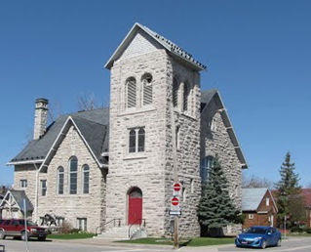
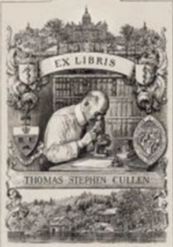
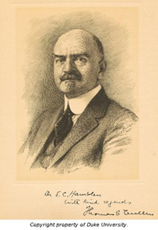
Reverend Thomas Cullen
Reverend Thomas Cullen (1836-1895) Methodist minister London Ontario
Thomas Stephen Cullen M.D. , 1868-1953 Belleville ,Ontario
M.D. University of Toronto 1890 Intern Toronto
Friend Lewellys Barker M.D. interned at J.H.H. - Howard Kelley M.D. canoe( fishing) trip Ontario 1891 – demonstration operation at U. Toronto – Cullen assisted – Kelley hired as intern
6 months in Welch’s lab – the resident in Gynecology
Rest of life at J.H.M.S . -Professor 1919 – taught until age 79
President Southern Surgical
Founded School of Art at J.H.M.S.- recruited Max Brodel and wrote biography of him 1894

Slide 11
Some non Johns Hopkins Surgeons

Slide 12
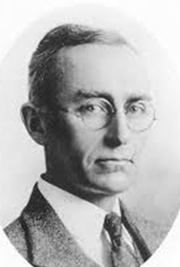
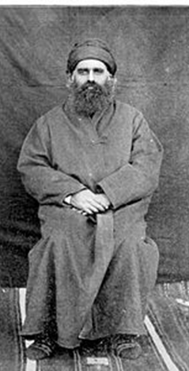
Reverend William Youel Allen
Reverend Allen D.D. Princeton 1836 – chaplain Texas house 1839, 1839 founded First Presbyterian Church of Austin and Houston , president Center College (Ohio) 1845 –Daughter Mary Louise married ( by him) in 1872 to
William Levi Whipple – Lane Theological Seminary Cincinnati – and on same day his classmate J. M. Oldfather
To Persia for American Bible Society as Missionaries to Nestorians (431 A.D.) in Oroomiah ( Urumiah, Urmia – N.W. Iran)
Allen Oldfather Whipple born 1881 – lived in Persia till age 8
Princeton 1904 A.B. – roommate Evarts Graham M.D.
Columbia U. Physicians and Surgeons 1908 M.D.
1911 > Presbyterian Hospital

Slide 13
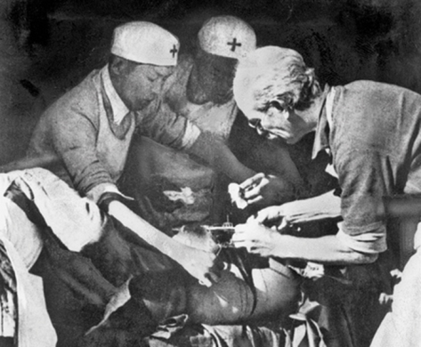
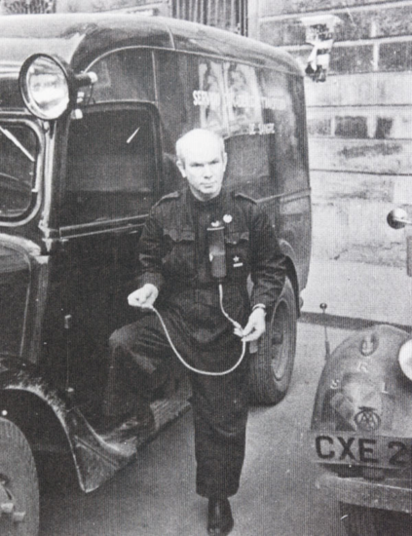
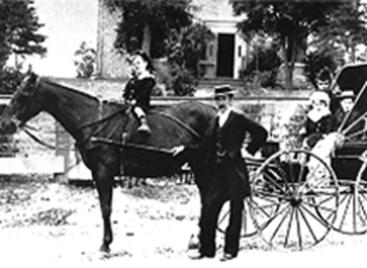
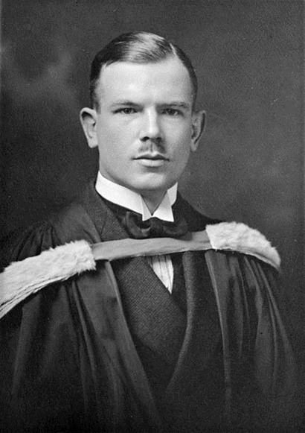
Reverend Malcolm Nicholson Bethune
Son Henry Norman Bethune M.D.
His Father Norman Bethune M.D. (1822-1892) surgeon – Guy’s Hospital London 1848 F.R.C.S.– one of founders of U. of Toronto
@ 10 Henry announced he was going to be a surgeon and was to be called Norman – hung his grandfathers Brass Name plate on his bedroom door
U. Toronto M.D. 1916 – Royal Navy WWI – London @ armistice – F.R.C.S.
Mobile blood transfusion service Spanish Civil War with Mackenzie Brigade 1936
Lobbied for Canadian Health System
China - head of Mao’s health service 1938 – died of sepsis after cut in OR November 1939

Slide 14
Why?
How many of you had minister parent ?
Education important
The Call to service
Books available
Religion losing influence
Medicine more scientific
Books available to all

Slide 15
Others
Albert Theodore Billroth
Dennis Parsons Burkitt
Adolph Meyer
William Sydney Thayer
Walter Reed
Thomas Futcher
Thomas Richmond Boggs
Andrew Taylor Still
Hermann Boerhaave
John Blair Barnwell
Jakob Levin Joseph
Moses Judah Folkman
Arnold William Klein
Jarl Gustav Jung
John and Charles Bell
Ivan Pavlov
Ernst Gustav von Bergmann
Mathew Baillie
Ashley Paston Cooper
Thomas Clifford Allbutt
Benjamin Collins Brodie
Henry Jacob Bigelow
Charles West
George Ballingall
Almroth Edward Wright
Peder Jacobsen Winslow
Albert Schweitzer
William Chester Minor
Petrus Camper
Carl von Linne (Linneaus)
Edward Anthony Jenner

Slide 17
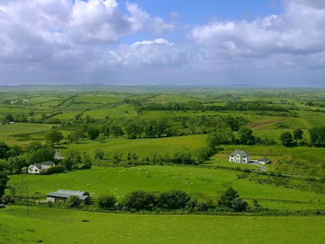
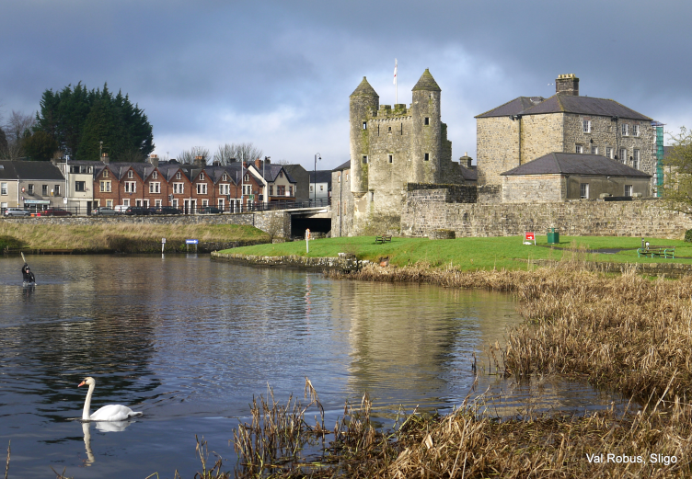
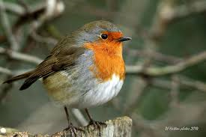
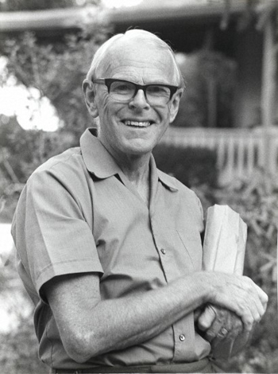
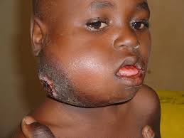
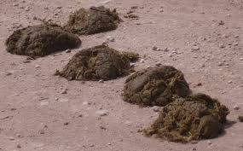
Reverend Thomas Henry Burkitt
Presbyterian Missionary in Athenry , County Donegal Ireland 1880’s .Married Emma Eliza Parsons- 7 children
Third son James Parsons Burkitt , Lawnakilla , Enniskillen NI – county surveyor 30 years and civil engineer , bridges , roads , canals - amateur but trailblazing ornithologist – European Robin , Erithacus rubeola – 1920’s banding
Their 3rd son Dennis Parsons Burkitt M.D. - lost eye in childhood accident
1929 trinity College Dublin – engineering – religious calling to medicine – R.C.S.I. 1938
Medical corps WWII
Post war Uganda Mission doctor
Noted unusual jaw tumor 1958
Noted no Western colonic disease-fiber intake colon health

Slide 18
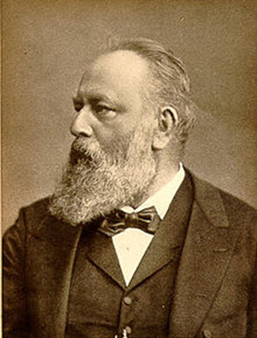
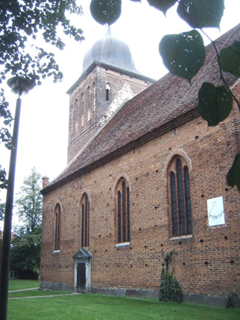
Rev Carl Theodore Billroth
Lutheran Minister Bergen auf Rugen Prussia
Swedish origin – died when young son 5 years old
Christian Albert Theodor Billroth M.D. - 1829-74
M.D. U. Berlin 1853
Prof U. Vienna 1867
John B. Murphy, W.S. Halsted students
White coat on doctors
1871 esophogectomy1881 gastrectomy

Slide 19
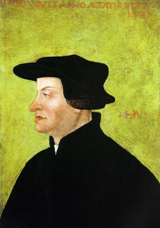
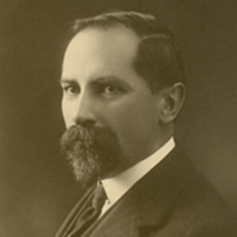
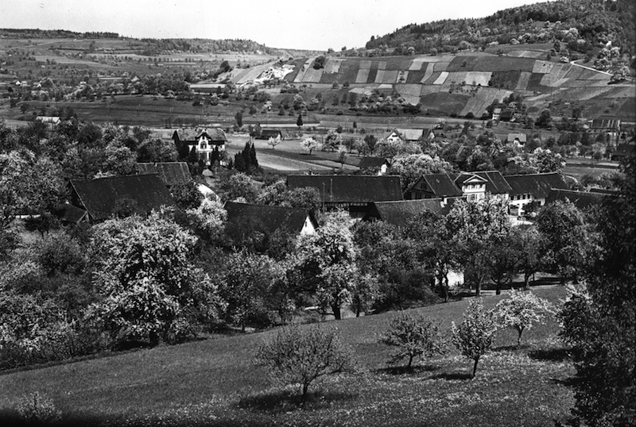
Father Rudolph Meyer
Zwinglian minister Niederweningen ,Switzerland
Huldrych Zwingli[a] (Ulrich Zwingli) 1484 – 1531 Swiss priest reformation pastor contemporary of Luther
Father of Adolph Meyer M.D. 1886-1950 M.D. University of Zurich 1892 - friend and follower of Freud
University of Chicago , mental hospital @Kankakee, IL. , state hospital at Worcester, MA, 1902 director of New York State Psychiatric Institute), Professor of Psychiatry at Cornell University from 1904 to 1909
Chosen to head JHU Phipps Psychiatric Institute 1908-1941
Careful History and follow disease
Ergasiology , psychobiology and occupational therapy

Slide 20
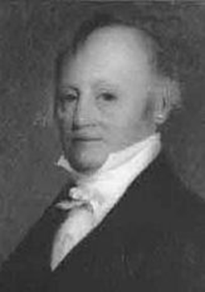
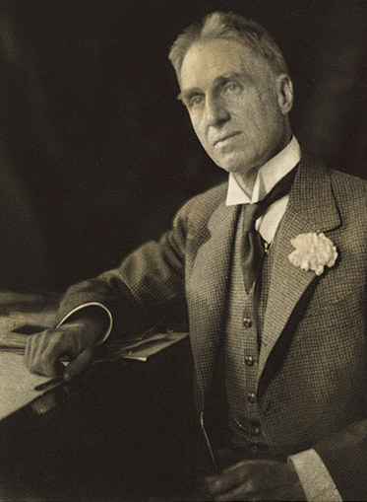
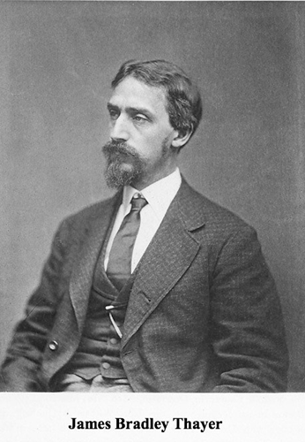
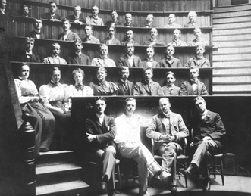
Reverend Samuel Ripley Professor James Bradley Thayer J.D.
Ripley - Unitarian (Universalist) Minister Waltham MA
His daughter Sarah Bradford Ripley married James Bradley Thayer J.D., Professor constitutional law Harvard
Their son William Sydney Thayer M.D. b. 1864 - Harvard A.B.1885,M.D. 1889, Intern MGGH 1890, Resident Physician with William Osler JHH 1890
Rest of Career at JHU- 1908 Professor of Medicine
Board of Overseers Harvard College (Brother Ezra Dean Harvard Law)
1898 – Latch keyer with Cushing
Expert on Malaria
President AMA 1927

Slide 21
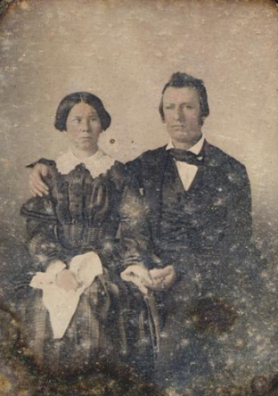
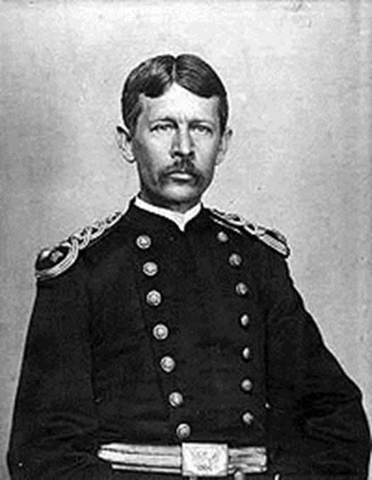
Reverend Lemuel Sutton Reed
Methodist (traveling) Minister
Married Pharaba White Reed
Son J.C. minister, son Christopher Lawyer Judge
Son Walter Reed M.D. born Gloucester Co., VA
Lived with Mothers family in Murfreesboro ,NC while father traveled and preached
1867 U, Virginia 1869 M.D. @ 18 youngest graduate
NY University Bellevue Hospital 1879 second M.D.
1875 joined Army Medical Corps
Pathology at JHMS with Welch
1900 yellow fever commission
1902 died ruptured appendix

Slide 22
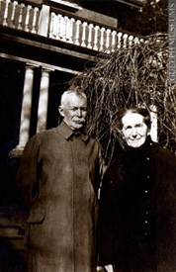
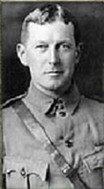
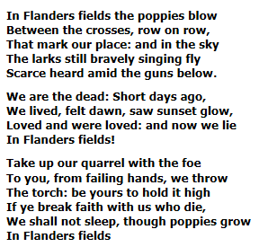
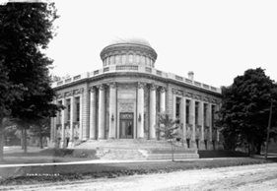
David McCrea
Rural Guelph , Ontario cattle (Galloway) farmer and breeder
Lover of books and education– founded Farmers and Mechanics Institute Library in 1850
Son Thomas McCrea b. 1870, M.D. Toronto , resident Johns Hopkins Hospital 1895, coauthor of Principals with Osler
1912 Professor Medicine Jefferson
D. 1935
Final illness mysterious-thought neuritis, ? lead intoxication – post mortem showed spinal arteriovenous malformation
Brother John McCrea , M.D. Toronto 1898, trained with Osler at Hopkins1899-1902, d. Flanders 1918 of pneumonia after writing “ In Flanders Fields”

Slide 23
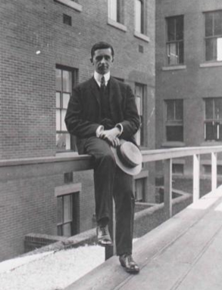
Thomas Futcher and Susan Northwood Futcher 1879
Parents of Thomas Barnes Futcher Jr. M.D. 1871-1938
Lived in Middlemarch ,Ontario ,Canada before church built Traveling Christian Readers came to town and held services in schoolhouse – stayed in Futcher home
University of Toronto M.D. 1893, Toronto General Hospital
1898-1901 resident Hopkins (latchkeyer with Jacobs and Cushing)– on faculty till he died
Son JHMS M.D. 1936 - Palmer Howard Futcher WO his godfather
Wife Gwendolen Marjorie Palmer Howard daughter of Walter Palmer Howard M.D.- Mentor Osler
Their daughter named Grace Revere Futcher

Slide 24
Reverend George Washington Boggs Reverend William Ellison Boggs
GWB Born Bethesda Congregation York Co SC 1796
AB Amherst College 1827
DD Princeton Theological Seminary 1831
1832-1838 Ahmednuggar Mission Bombay India – Then Presbyterian Minister SC 1841-7
Son William Ellison Boggs b. India 1838 – AB SC College (USC )1859 – Columbia Theological Seminary 1862, DD Southwestern Presbyterian 1873 – Chaplin 6th SC CSA
Taught in Tennessee and then U Ga. – later Chancellor 1889-1898 –d. Baltimore 1920
Thomas Richmond Boggs M.D. b. Memphis TN
1875 , U Ga 1896 , U Penn 1897-8,JHMS M.D. 1901
Osler’s last living Resident 1938
Chief of Medicine Baltimore City Hospital @ Bayview 1911-38
Chief of Medicine Hopkins Hospital WWI
From the older Ox the
younger learns to plow

Slide 25
Reverend (Doctor) Abraham (Abram) Still M.D.
1796-1867 –b. Buncombe Co, NC
Methodist Episcopal Minister ( traveling) and physician –Virginia , Kansas ,Missouri
In 1844 when ME Church split into ME and ME South Still remained with ME – the abolitionist wing
Missionary to Shawnee Indian tribe at Wakarusa , KS
Son Andrew Taylor Still b. 1828– Lee Co Virginia
Moved with Family to KS and MO - read medicine with his father
Union Army Hospital Steward Civil War
After wife and three children died of infection (meningitis, influenza) in 1864 ATS abandoned Regular ( allopathic) medicine and founded Osteopathy
d. 1917

Slide 26
Reverend Anton Julius (AJ) Carlson Ph.D.
Anton Julius Carlson b. 1825 Sweden, US Augustana College Rock Island IL. 1898 , Ph.D. Stanford 1902 – 1904 > 1940 Physiology University of Chicago
1899 assistant minister Swedish Lutheran Church Anaconda ,MT.
Lester Reynold Dragstedt M.D. b. Anaconda 1893 to Swedish immigrant parents
Carlson lived with LRD’s uncle Charles and his family in Anaconda
As child read and memorized Bible verses
High school valedictorian – scholarship to University of Chicago B.A. 1915,M.A. ‘16,Ph.D. , M.D.’21 (Rush)
1920—59 Chicago ( chair ’48-’59)
360 papers
Vagotomy 1943

Slide 27
Nobels
Irene and Frederick
Joliet - Curie
1935
Marie and Pierre Curie
1903 (M+P) , 1911(M)
2006
Roger
Kornberg
1959
Arthur
Kornberg
1975
Aage Bohr
1922
Neils Bohr

