Slide 1
Owen Wangensteen, Jerome Urban, and the Hunt for Extraaxillary Lymph Node Metastases from Breast Cancer
Todd M. Tuttle, M.D.
University of Minnesota
Minneapolis, MN
Halsted Surgical Society
Philadelphia, PA
2015

Slide 2
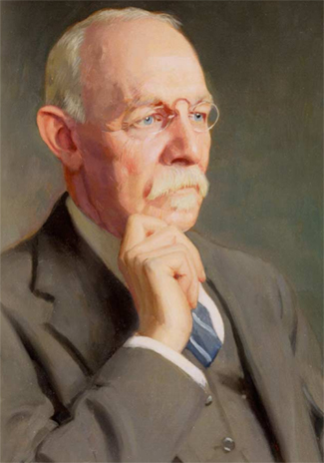
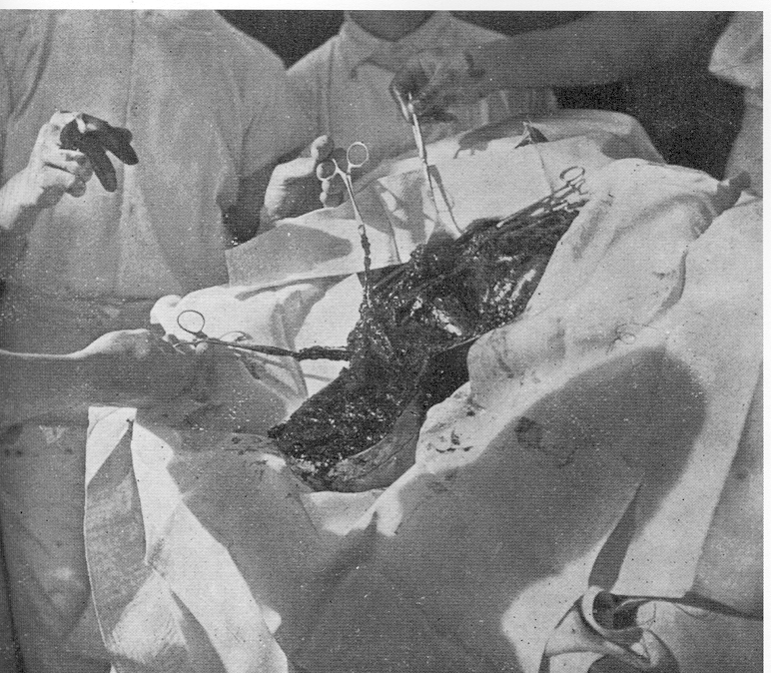
William Steward Halsted, 1894
Radical Mastectomy:
Skin
Breast
Pectoralis muscles
Axillary lymph nodes
Halsted W, Ann Surg 1894

Slide 3
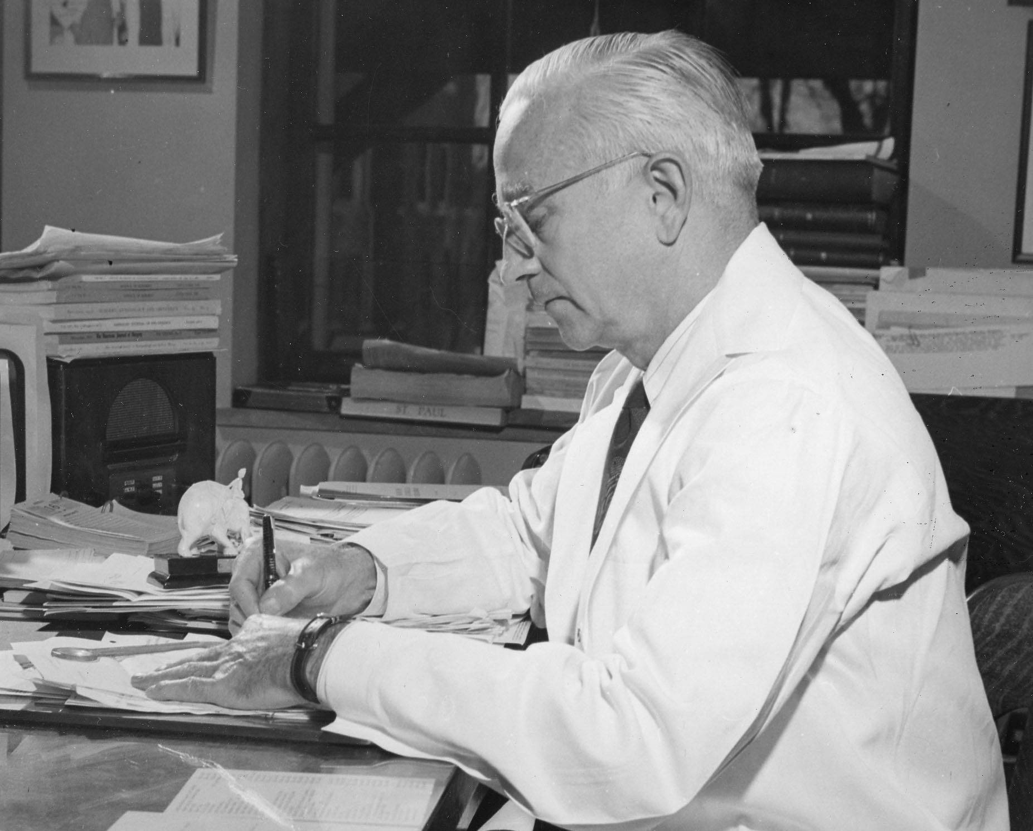
Owen H. Wangensteen, 1949
“Today, it should be said, I believe, the Halsted operation for cancer of the breast is outmoded…
it is not radical enough.”

Slide 4
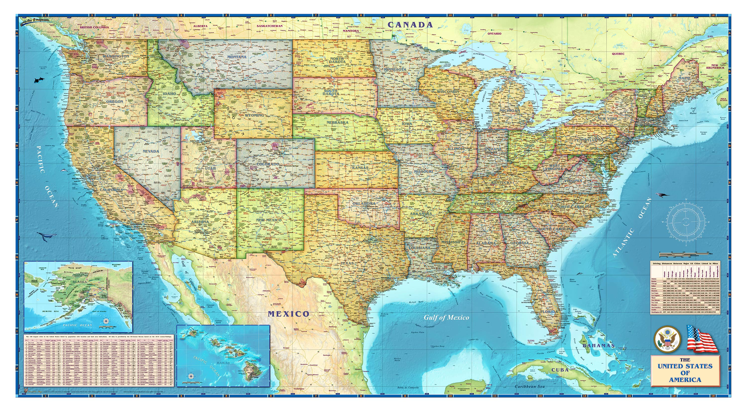
Hunt for Extraaxillary Lymph Node Metastases
Wangensteen
Minneapolis
“Super-Radical”
Urban
New York City
“Extended-Radical”

Slide 5
Before Wangensteen and Urban
53 pts with radical mastectomy + supraclavicular LN dissection
23% +supraclavicular LNs
“Our rule should be, operate on the neck in every case.”
Halsted 1898

Slide 6
Before Wangensteen and Urban
1927: WS Handley, Middlesex Hospital
Placement of radium tubes in the intercostal spaces
1949: Richard Handley and AC Thackray
50 patients with mastectomy plus removal of ipsilateral internal mammary LNs through 2nd intercostal space
38% had IM LN metastases
Handley WS. Surg Gynec and Obstet 1927
Handley RS, Thackray AC, Lancet 1949
Notes:
WS Handley reported that inernal mammay lymph nodes often contain breast cancer metastases

Slide 7
Before Wangensteen and Urban
1949: Andreassen and Dahl-Iversen, Copenhagen: dissection of supraclavicular LNs
1949: McWhirter, Edinburg: simple mastectomy followed by radiation therapy to IM LNs
Andreassen M, Dahl-Iversen E. J Intern Chir 1949
McWhirter R. Arch Surg 1949

Slide 8
Cancer Treatment In the US Late 1940s-Early 1950s
Very limited staging studies
Radiation therapy not widely available
No effective chemotherapy
No endocrine treatment
Scalpel most effective cancer-fighting tool

Slide 9
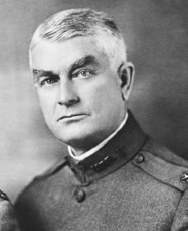
Wangensteen
Born and raised on a farm in NW Minnesota
Intestinal obstruction, appendicitis, peptic ulcer disease, and 2nd look cancer operations
Notes:
Spent his entire professional life at the U Min
His clinical and researchec interestes included

Slide 10
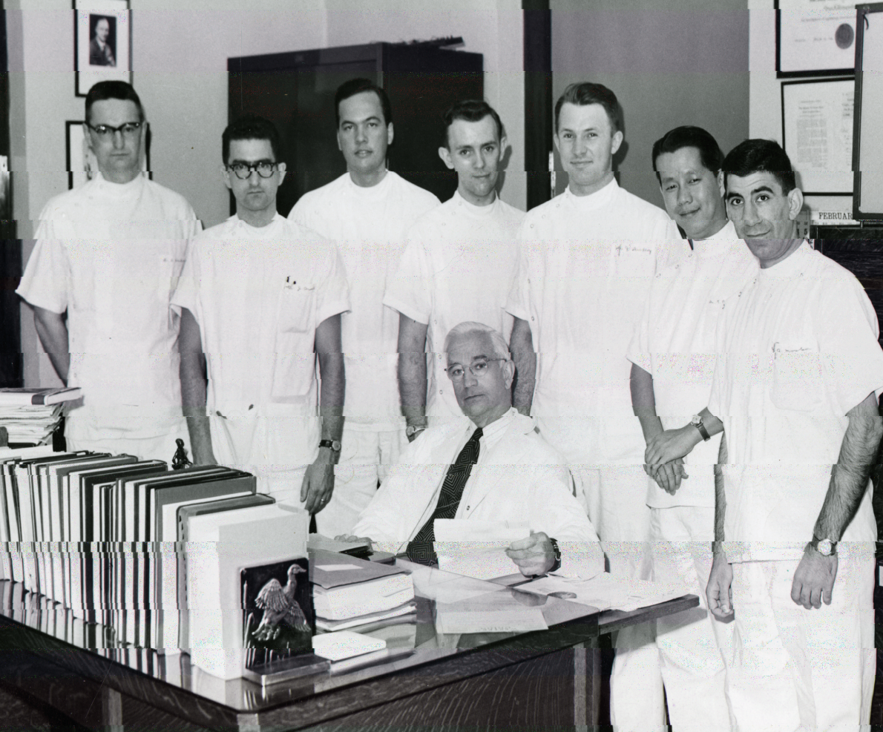
Notes:
Wangensteen was a strong proponent of surgical resident research and established the Surgical Forum at the American College of Surgeons (ACS) - Several years ago at this meeting, Selwyn Vickers gave a presentation on Wangensteen’s contribution to the development of academic surgical training programs in the US.

Slide 11
“I have felt on occasion in attacking cancerous lymph nodes extending up along the axillary vessels to the point where the vessels pass over the first rib, much like a hunting dog must feel when he is chasing a pheasant and the pheasant flies over a fence. The surgeon has the alternative, of course, of taking down the fence.”
Notes:
For Wangensteen, the clavicle and sternum rpresented anatomic barriers to a more complete operation; the super radical mastectomy wa s his method of taking down the fence.

Slide 12
“Super-Radical Mastectomy”
November 1948: first operation
April 1949: report of first 5 patients at American Surgical Association

Slide 13
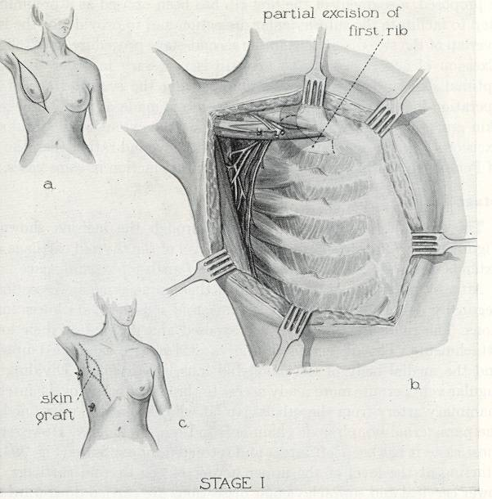
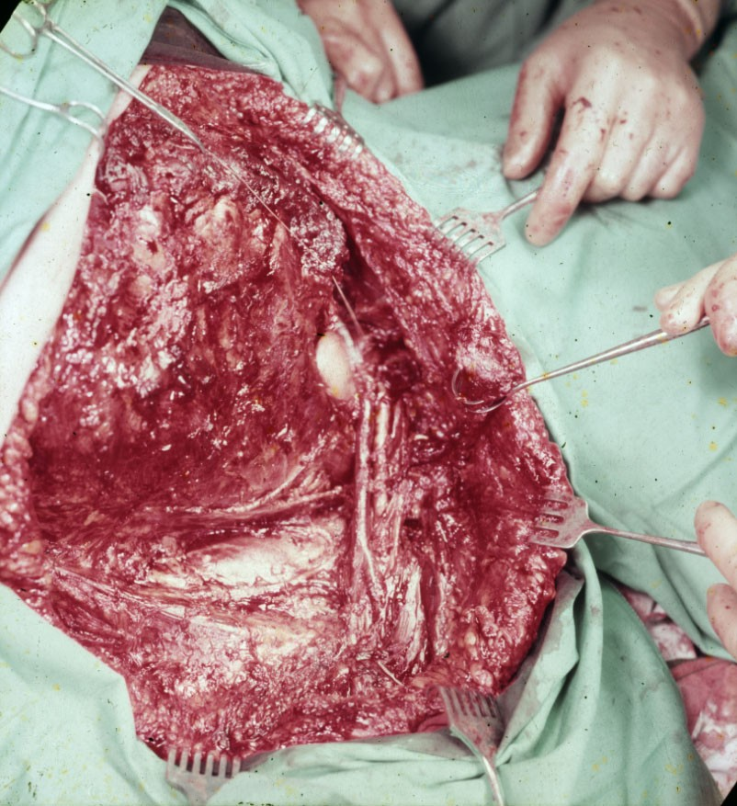
Super-Radical Mastectomy, Stage I
Wangensteen, Surg Clin North Am 1956
U Minnesota Archives
Notes:
Wangensteen initially advocated a 2-stage operation. In stage 1, In stage 1, the conventional mastectomy was performed throu the usualy elliptical incision, then a sement of the first rib was resected. The wound was then closed with either primary sutures of a split-thickness skin graft, depedning on the extent of the local skin excision.

Slide 14
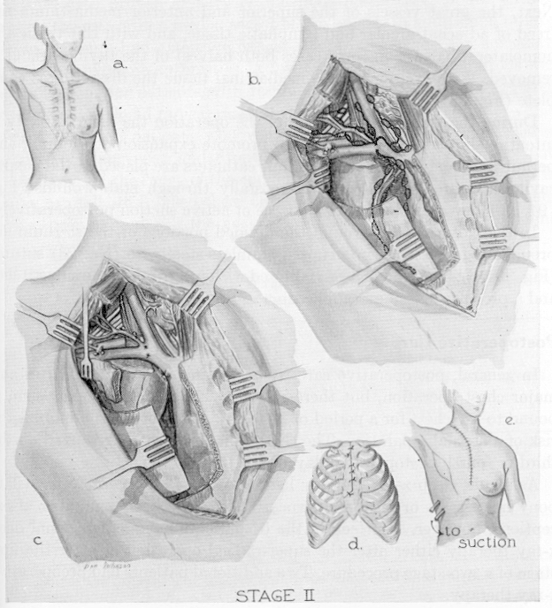
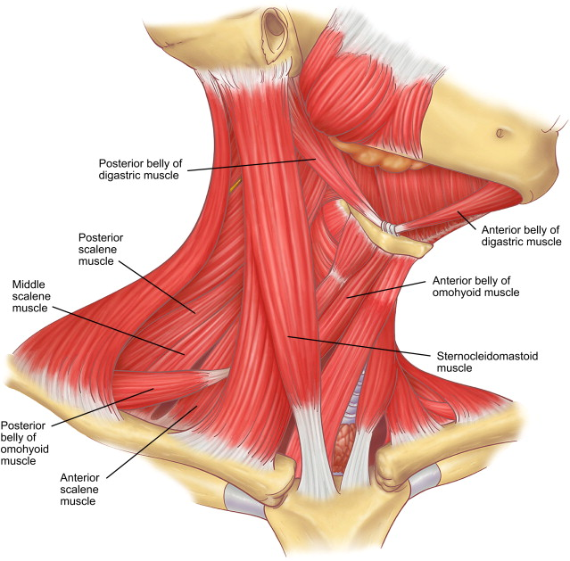
Super-Radical Mastectomy, Stage II
Wangensteen, Surg Clin North Am 1956
Notes:
In stage 2, performed 4-6 weeks later, Wangensteen created a separate incision that extneded from the thyroid cartilage down to the sternum, ending at the fourth intercostal space. The sternocelidomastoid muscle was detaached at its lower insertion The strap muscles were divided at their lower attachments. The carotid sheath was dissected and the omohyoid muscle divivided. The supraclavicular LND started at the upper border of the thyroid cartilage and extended into the mediastimum. The sternum was cut longitudinally from the jugular notch to the 4th ics and then cut transverely at the 4th ics. The clavicle and half of the manubrium were then retracted laterally to expose the subclavicular area. The barchial plexas and subclavian vessels were dissected and all lymphatic tissue was removed.

Slide 15
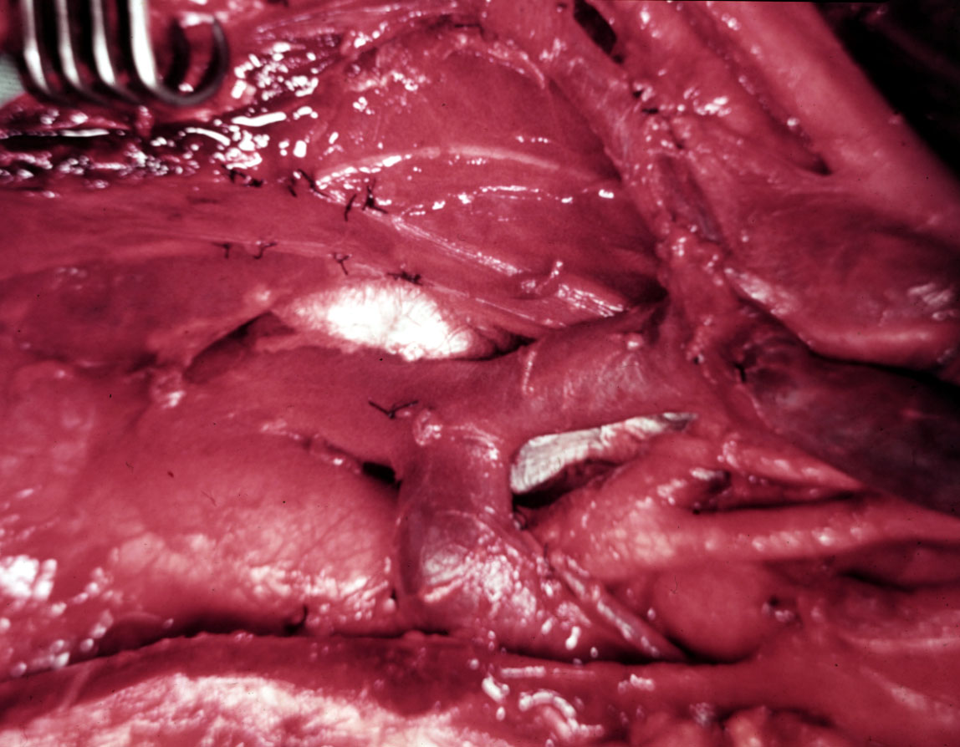
SVC
LIV
AA
LCCA
U Minnesota Archives
Notes:
Next, the divided sternum was retraced, exposing the tissues of the anteria mediaturme. The int mammary vessels and associated lymph node chairs were removed from the origin of the vessels in the neck down to the firth ics. Thad adjuvance pleura and fat were widely excised along with the internal mammary lymph nodes the lympatic tissues were dissected from the great vessels of the superior and anterior mediastinum. The sternum was closed with interrupted stainless-steel wire, and the skin was closed.

Slide 16
Super-Radical Mastectomy Indications
Wangensteen used the procedure selectively
Medial tumors
Known axillary lymph node metastases
Wangensteen O Surgical Clin North Am 1956

Slide 17
Incidence of Extraaxillary Lymph Node Metastases
Lymph Node Basin Metastases (%)
IM only 25%
IM + supraclavicular 27%
Supraclavicular only 6%
Overall 58%

Slide 18
Super-Radical Mastectomy
64 patients
Operative mortality, 12.5%
5-year survival rate: 17%
Wangensteen’s conclusion: “disappointing”
Wangensteen O. Surg Clin North Am 1956
Notes:
He predicted that if radiation therapy proved effective, then super-radical mastectomy would not be necessary.

Slide 19
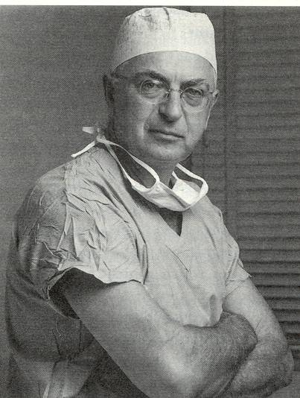
Jerome A. Urban, M.D.
Born in the Bronx 1914
Columbia University College of Physicians and Surgeons
Acting Chief of Breast Service
1974: Radical Mastectomy on Happy Rockefeller
Notes:
Dr. Urban was born in Brooklyn in 1914. A 1938 graduate of the Columbia University College of Physicians and Surgeons, Dr. Urban served his internship at Lenox Hill Hospital and in 1944 joined the staff of Memorial Hospital for Cancer and Allied Diseases, a division of Sloan-Kettering.
He served as a lieutenant in the Navy Medical Corps during World War II and afterwards resumed his position at Memorial. He was a clinical assistant surgeon, an attending surgeon and from 1974 to 1976 was acting chief of the breast service.

Slide 20
Urban Studies Before Extended-Radical Mastectomy
Medial tumor location was associated with a worse survival rate
More than 70% of all chest wall recurrences after radical mastectomy were in the parasternal region
Urban JA Cancer 1952
Urban JA Cancer 1951
Notes:
Based on these 2 studies, Urban hypothesiszed that present in the interanl mammary lymph nodes that conventional surgery could not treat.

Slide 21
Extended-Radical Mastectomy
First described: James Ewing Society March 7, 1952
Radical mastectomy plus en bloc resection of IM nodes
Called it “an effective surgical attack upon the primary breast cancer together with both of its primary depots of lymphatic drainage.”
Notes:
Urban designed an orginal operation for removing the internal mammary lymph nodes enbloc with radical mastectomhy

Slide 22
Extended-Radical Mastectomy
Urban JA Surg Clin North Am 1956
Notes:
Made an elliptical skin incision in the manner of a conventional radical mastectomy. Raised skin flaps medially to the opposite side of the sternum and then laterally to the outer aspect of the latissumus muscles. The pect muscles were dissected and the anterior surface of the sternum was cleared. The pecotroalis major muscle was divided between the sternal and clavicular heads, exposing the first rib. From below, the anterior rectus muscle was divided, exposing the 6th rib. Next, an incision was made through the intercostal muscles and pleura in the first ICS. The internal mammary vessels weere transected and ligatted behind the lwoer edge of the first rib. In a similar manner the 5 tcs WAS ENTERETED AND THE INTERNAL MAMMAY VESSELS WERE AGAIN TRANSECTED. A TRAP DOOR WAS FASHINED IN THE CHEST WALL MY JOING THE INTERCOSTAL INCISIONS USING A STERNAL-SPLITTING INCISION. This portion of the chest wall was then separated by cutting through the ribs and intercostal muscles just lateral to the costal-chondral junctions of the 2-5th ribs. The free portion of the chest wall with the internal mammary chain was then reflected laterally, remaining in contin;uity with the overlying pect muscles and breast.

Slide 23
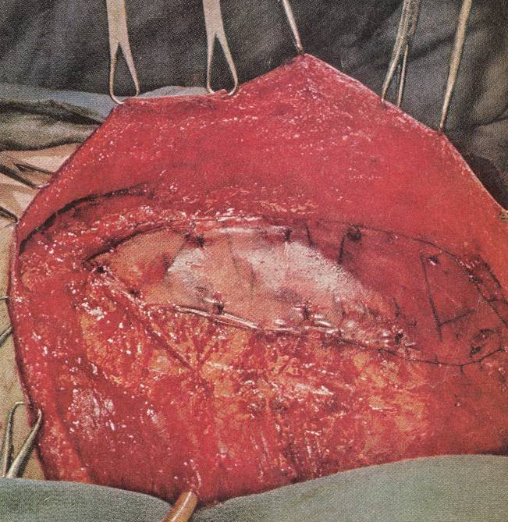
Time Magazine May 3, 1963
Notes:
Next, the chest wall defect was closed with a fascia lata graft. The pleural cavity was routinely drained for 2 days.

Slide 24
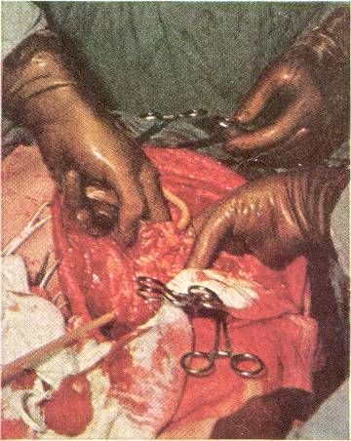
Surgery: the Best Hope of All
Notes:
Urban treated about 1000 patients with extended-radical mastectomy for several decades. His operation was featured in a Time Magazine cover story in 1963 highlighting 7 innovative operations. The title of the article was Surgery: the best hope of all.

Slide 25
Extended-Radical Mastectomy Outcomes
No postoperative mortality
“Actually, very little increase in postoperative morbidity”
Operating time: 4-5 hours
Mean transfusion: 3 pints
Mean hospital stay: 8 days

Slide 26
Survival After Extended-Radical Mastectomy
Variable 5-year Survival
Ax + IM LNs negative 87%
Only Ax LNs positive 68%
Only IM LNs positive 64%
Ax + IM LNs positive 54%
Urban JA, Am J Roentgen 1971; Urban JA, Int J Radiat Oncol Biol Phys 1977

Slide 27
Survival After Extended-Radical Mastectomy
10-year survival rate at Memorial Hospital
Extended-radical mastectomy: 54%
Radical mastectomy: 33%
Urban JA Cancer 1976
Notes:
In 1976, Urban reported that the 10-year survival rate at memorial hospital was significantly improved for extended radical mastectomy as compared to conventional mastectomy.

Slide 28
Comparison
 | Wangensteen Super-Radical | Urban Extended-Radical
Indications | Medial tumors; Ax LN metastases | Central or medial tumors; stage I/II
Type | Not en bloc | En bloc
LN Basins | Ax, IM, SC, mediastinal | Ax, IM

Slide 29
Randomized Clinical Trials
Extended-Radical Mastectomy vs. Conventional Mastectomy
No improvement in survival
Lacour J, Eur j Surg Onc 1987; Morimoto T Surg Today 1994

Slide 30
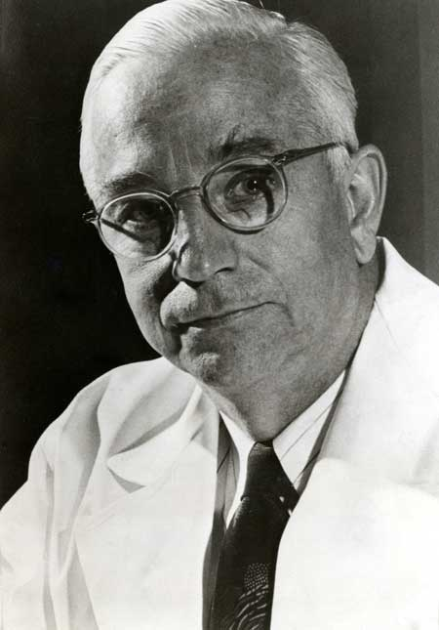
Legacy?
Notes:
Some argue that despite their bold and innovative work, that the accomplishments of wangensteen and urban are relegated to a foot note in history. But, to quote a well known college football announcer,

Slide 31
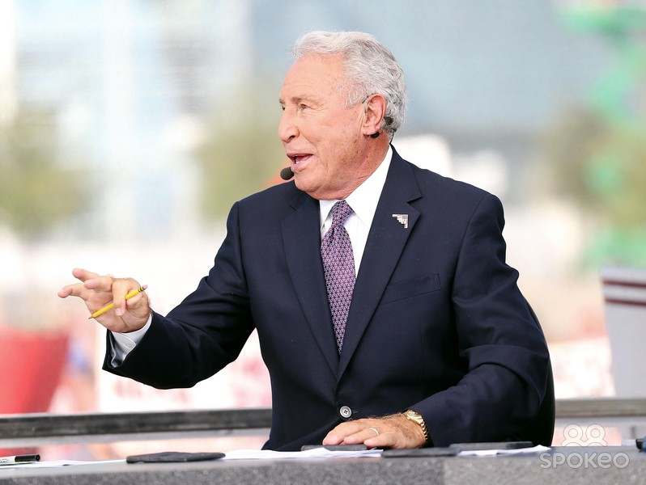
Not so fast, my friend!

Slide 32
Notes:
7 weeks ago, the NEJM published 2 separate randomized clinical trials evaluating the treatment of extra-axillary LN mets with RT. These 2 studies demonstrated that

Slide 33
Radiation Therapy and Extraaxillary Lymph Nodes
MA-20 and EORTC
Decreased locoregional recurrence
No significant improvement in overall survival
Notes:
So, nearly 70 years after Wangenseen and Urban proposed surgical treatment of extraaxillary LNs, there remains intense in the management of extraaxillary lns

Slide 34
Wangensteen and Urban Summary
Recognized that a substantial proportion of patients had extraaxillary LN metastases
Understood that that these LN metastases are untreated
Developed a unique treatment with the available tools
Work served as a model for subsequent treatments and trials

