Slide 1
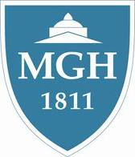
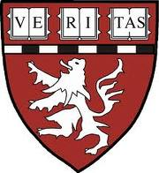
Edward D. Churchill – Father of the Modern, “Rectangular” Surgical Residency
John T. Mullen, MD
Program Director, MGH General Surgery Residency
Assistant Professor of Surgery, Harvard Medical School
88th Annual Halsted Society Meeting
September 12, 2014

Slide 2
The Halsted Society
“I would like to say that the real success of the organization depends entirely upon its membership . . . Three or four dead weights or one real second-rater and the club will be no better than the American Medical Association.”
-- Letter from Dr. Harry Murray to Dr. Percival Bailey, two founding members of the Halsted Society

Slide 3
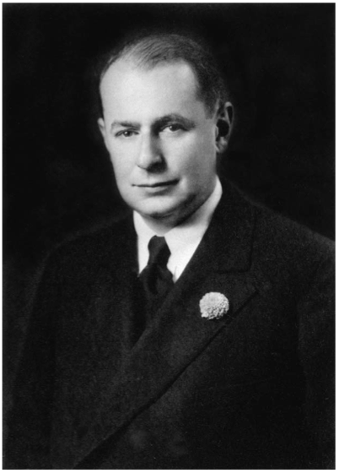
Grillo HC. Surgery 2004;136:947-952.
Notes:
Edward Delos Churchill, circa 1939, the John Homans Professor of Surgery, HMS, Chief of the Surgical Services, MGH, who presented the first keynote address at the first meeting of the Excelsior Surgical Society, a group of 80 medical officers who met for the first time in 1945 at the Excelsior Hotel, Rome, Italy. This prestigious lecture is given annually at the ACS Clinical Congress in honor of Dr. Churchill.
Received the Distinguished Service Medal for his care of the wounded
President of the American Surgical Society in 1946
President of the AATS in 1949
Member of the Halsted Society

Slide 4
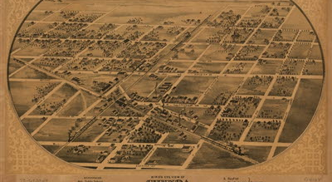
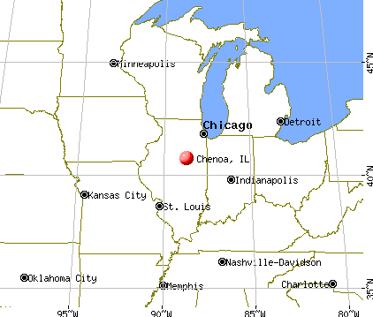
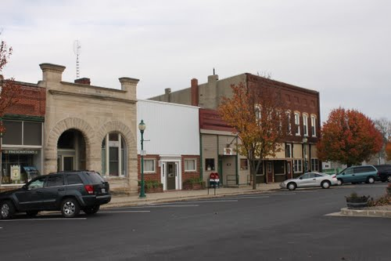
Chenoa, Illinois
Notes:
Edward Delos Churchill was born on Christmas Day in 1895, the third son of Ebenezer Delos and Maria Churchill, in Chenoa, IL.
The family was staunchly Presbyterian, close knit and self-contained, having a special sense of responsibility to make the most of his given talents.
His grandfather, also Ebenezer Delos Churchill, settled in Chenoa when it was a very small place on the prairie where two railroads were later to cross.
Chenoa is located at the crossroads of historic Route 66 and U.S. Route 24, approximately 110 miles southwest of Chicago and 190 miles northeast of St. Louis.
The population was approximately 1300 in 1895, and it has a present-day population of only 1800.
He was a grain dealer, and his grain elevator was a personal business, E.D. Churchill and Son.
Chenoa failed to develop into an important grain transport center, and so Churchill’s parents brought up their three sons to assume that they would not remain there.
All three sons graduated from college: the oldest, Frank, from Northwestern; Clarence, the second son, from the Univ of Illinois; and Edward, from Northwestern.
Frank joined the family firm and Clarence moved westward to Idaho Falls.

Slide 5
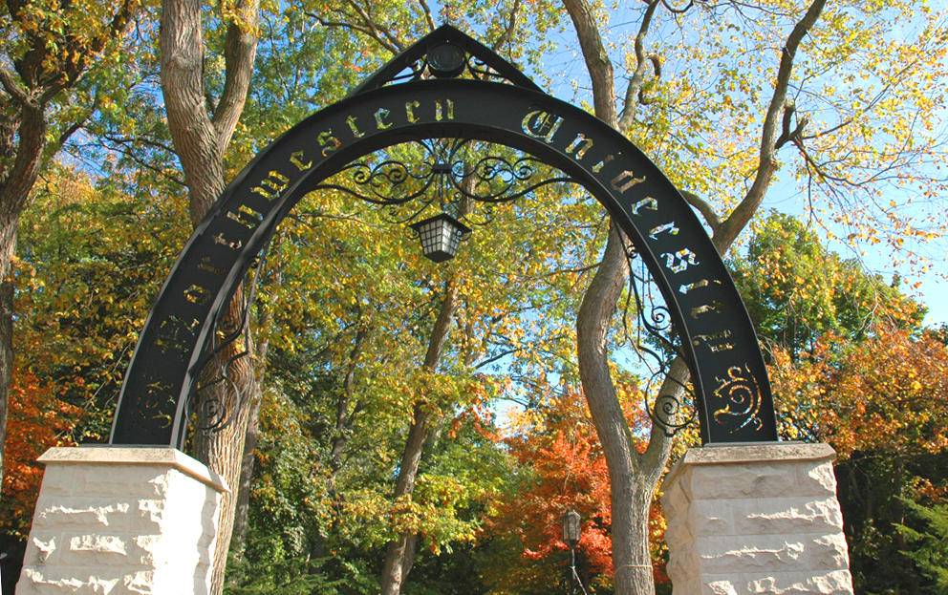
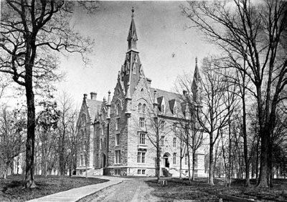
Northwestern University 1912 – 1917
Notes:
In 1912 he entered Northwestern University, then a small Methodist-dominated college in Evanston, which his brother Frank attended.
He majored in biology under two remarkable teachers – William Locey and Sidney Kornhauser, who became his lifelong friend.
Kornhauser’s influence, Churchill spent an extra year at NU to earn a Master’s degree in biology, which qualified him to enter the second year class at HMS.

Slide 6
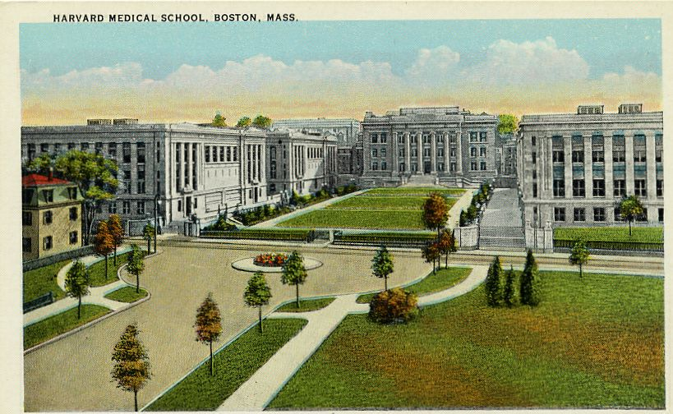
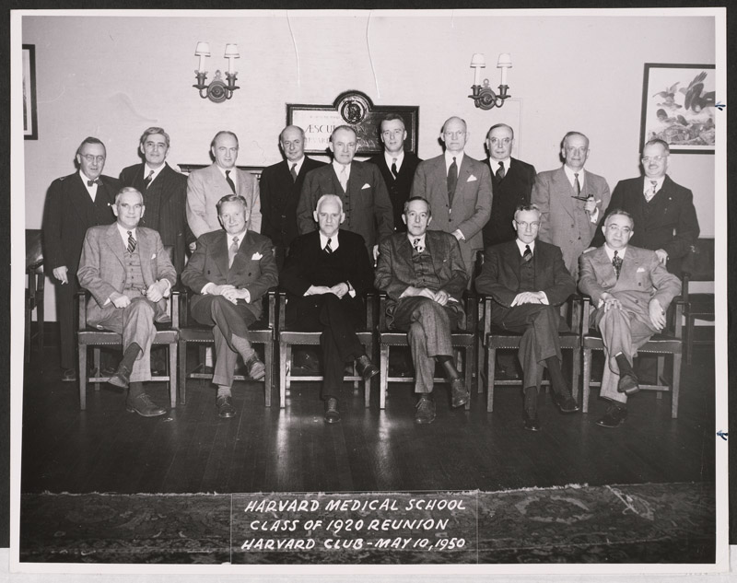
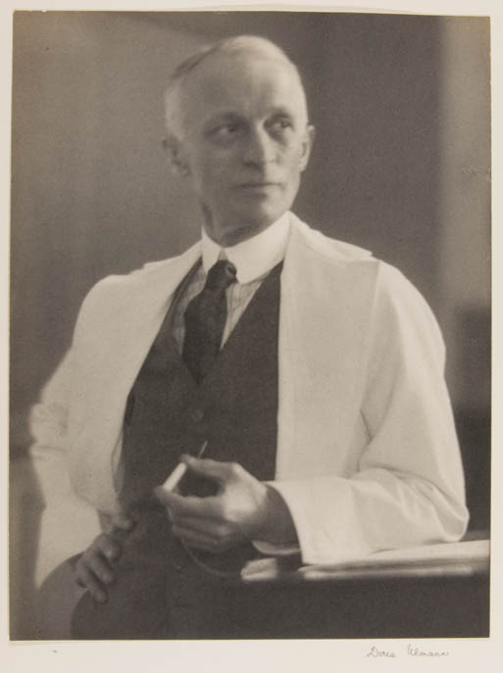
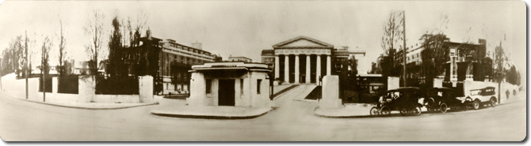
HMS 1917 – 1920
Notes:
EDC entered HMS as a transfer student in the second year class, but he arrived self-confident and prepared from NU, and he earned the top mark in his class in pathology, considered the important course of the curriculum.
In his final year he lived as a student intern at the Faulkner Hospital, a highly regarded suburban hospital not far from Boston.
This clinical experience was critical in Churchill’s decision to enter surgery, as it brought him into close contact with two excellent surgeons, Franklin Balch and Edward Young, both active at the MGH, and this inclined him to the MGH for his post-graduate training.
He thus arranged to have his undergraduate course in surgery at the Peter Bent Brigham, to which Harvey Cushing had recently returned from the War.

Slide 7
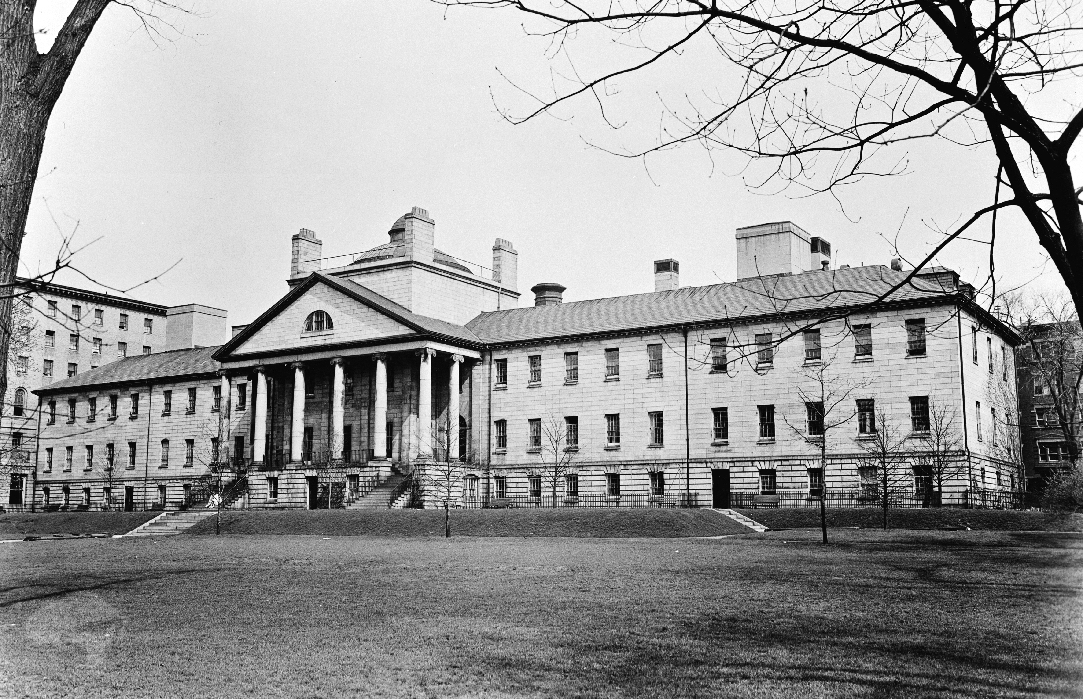
MGH in 1920
Notes:
In his senior year, 1920, EDC was accepted on the West Surgical Service at the MGH after on oral exam similar to the ones we give today.
At that time there were two surgical services, East and West.
Both were clinically oriented, but because C.A. Porter, Chief of the West, was also John Homans Professor of Surgery, the West was identified as the teaching service – an identification which lasted during the 20s under Porter and E.P. Richardson and in the 30s under Churchill.
Churchill spent two years as House Pupil and two years as Resident Surgeon on the West.
They were busy clinical years, but less responsibility was delegated to the H.O. or resident.
Each service was conducted at the discretion of the senior staff – “Visiting Surgeons” – who often did much of the operating themselves.
Surgical training at the MGH was a far cry from the Halsted system at JHU.
The surgeons at the MGH were in private practice and thus were “Visiting Surgeons” at the MGH, not full-time faculty.
Halsted and his staff were full-time faculty who limited their professional activities to the one institution from which they derived their financial support, and they were expected to teach and do research.
In Boston, the nearest approach to the Halsted system was apparent at the PBBH, not surprising, as Harvey Cushing was chief and a disciple of Halsted’s.
As we shall see, one of the challenges that occupied much of EDC’s attention as Professor and Chief during the 30s and 40s was the integration of a full-time concept which implied research as well as clinical activity into the MGH surgical staff.

Slide 8
It’s not my intent to be a harsh critic of the generation of surgeons
under whom I served my apprenticeship at the M.G.H. They had been
conditioned as apprentices to the standards of the generation that
preceded them, and attitudes change slowly when a practical art is
passed along from master to neophyte. But what I found most
disturbing at the time – and now in retrospect – was the attitude of
complacency, the smug suppression of intellectual curiosity. . . .
Yet with few exceptions, the surgeons were anti-scientific and
anti-intellectual in their attitudes and in the example they were
setting to the oncoming generation.
One Visiting Surgeon told me: ‘Do not bother me with any new
ideas. I know enough now to last me the rest of my surgical life and
do not want to learn anything more.’ Amory Codman, Charles Scudder
and J. Collins Warren, all of whom had retired, would have been
more to my liking, but I saw little of these men. -- EDC
Notes:
In his memoirs, Churchill describes how the lasting impressions of his own experience as House Officer and Resident greatly colored his thinking when, as Professor and Chief, he engineered the transition from a master-apprentice training to surgical resident education.

Slide 9
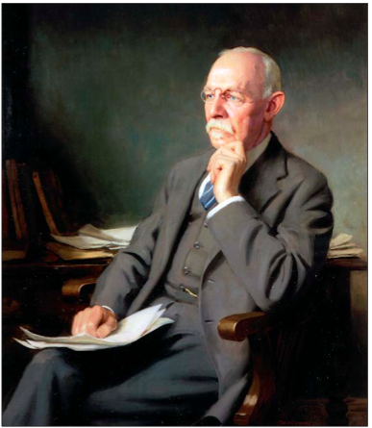
Osborne MP. Lancet Oncology 2007;8:256-65.
Notes:
In 1889, Halsted introduced a new, transformational and progressive and science-based surgical training program at Johns Hopkins University
Up until this time, there were no formal training programs in surgery, and most surgeons were self-taught and in private practice, like at the MGH
There was a good deal of competition, and few wanted to teach their craft to others.
Halsted modeled his system closely on the German plan, as he was greatly impressed by the German surgeons during his European studies
Under one chief and indefinite in length, the program was highly competitive for both entry and advancement
From the large number of house officers entering the program, only one, called the “resident”, completed it.

Slide 10
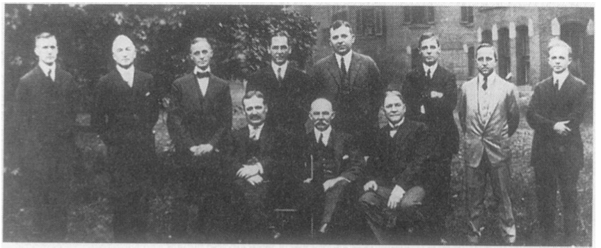
“Halsted’s School” 1914
Notes:
Indeed, during his 32 years as Professor and Chief, and if my math is correct that Halsted took in some 256 interns (8 x 32), he only graduated 17 residents, of whom 13 remained in academic surgery, including 7 chairmen:
Harvey Cushing, BWH
Stephen Watts
J. M. T. Finney
George Heuer
Mont Reid
Emil Holman
Joseph Bloodgood
4 went into private practice
11 set up residency training programs
Halsted’s development of a system for training surgeons was perhaps his greatest contribution to our surgical heritage.
These were some of the men from “Halsted’s school” that spread the Halstedian residency training system throughout the US.
Seated were Finney, Halsted, and Bloodgood. Standing includes Cushing and Heuer (far right).
Among the centers that adopted the Halsted pyramidal system were Yale, PBBH, and Duke.
In 1935, George Heuer, a Halsted resident and chairman of Surgery at Cornell, identified 15 university programs that were similar to Halsted’s system.
In 1938, the SUS, which required the completion of a Halsted-type residency for membership, identified 17 programs, including MGH, which is notable, since EDC opposed the Halsted system.

Slide 11
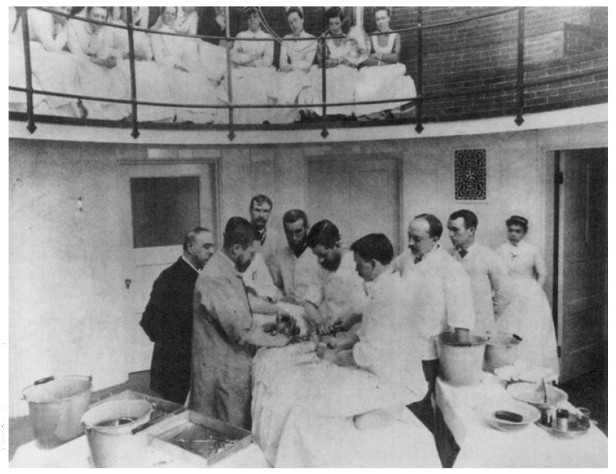
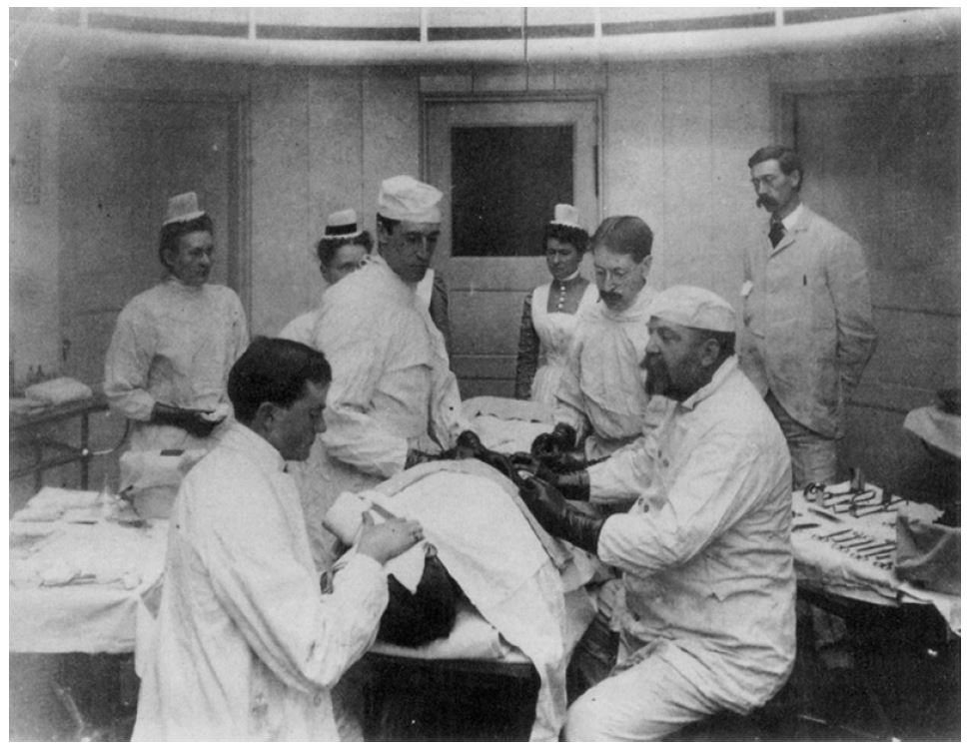
1924 – 1926
Notes:
Following residency he became instructor of surgery, earning a living by assisting senior staff surgeons, the “Visiting Surgeons”, such as C. A. Porter, Jason and Charles Mixter, and Daniel Fiske Jones, a highly disciplined and competent surgeon who was responsible for the introduction of the APR to the US and was President of the ASA in 1933.
Churchill also worked part time with Cecil Drinker in the Physiology Lab at the HSPH. Drinker’s interest lay primarily in the physiology of the heart and lungs, and this experience combined with the excitement of the new field of chest surgery, led him to consider travel abroad to see for himself what was being or could be done.
So he was granted a traveling fellowship, a Moseley Travelling Fellowship from HMS, a grant of $1800 per year for the year 1926-1927, his so-called “Wanderjahr”.

Slide 12
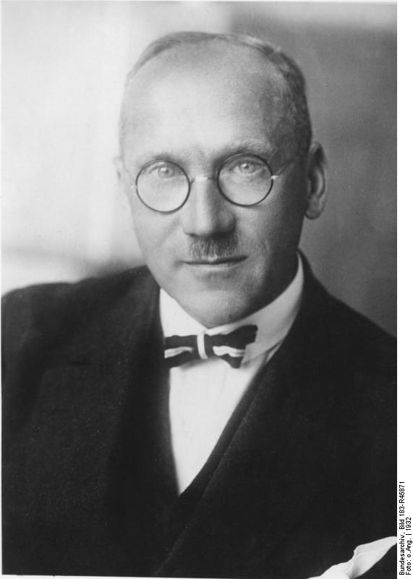
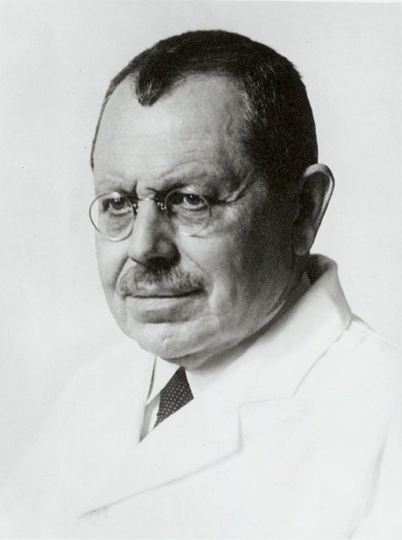
Churchill’s Wanderjahr
Moseley Traveling Fellowship
1926 – 1927
Scannell JG, editor. Wanderjahr: the education of a surgeon. Boston, 1990.
Notes:
Blair Bell in Liverpool
Berlin and Prague
Sauerbruch in Munich
deQuervain, Kocher’s successor, in Bern
Enderlen in Heidelberg
Krogh in Copenhagen
Brauer in Hamburg

Slide 13
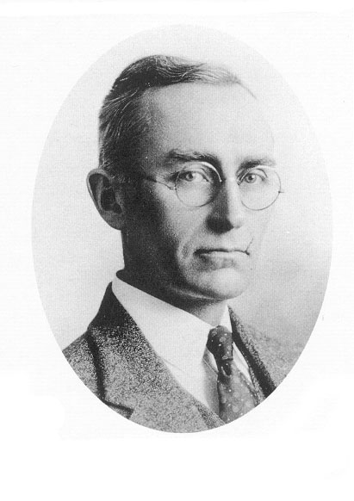
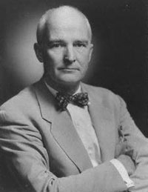
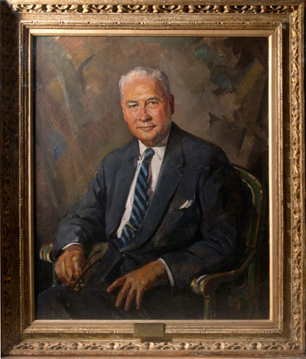
1927 - 1931
Notes:
Returned to full-time work at MGH under E. P. Richardson on the West Service in 1927
Called away to help create a full-time Surgical Unit at the Boston City Hospital in 1928
In 1929 was offered a job to direct surgical research at Columbia-Presbyterian by Allen O. Whipple
He returned to MGH in March 1930 as Associate Professor
Worked in cardiopulmonary physiology, particularly the problem of pulmonary embolism, alongside John Gibbon
Became the John Homans Professor and Chief of the West Surgical Service in 1931, at the age of 35

Slide 14
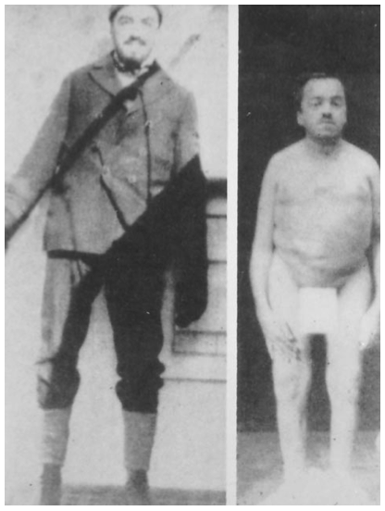
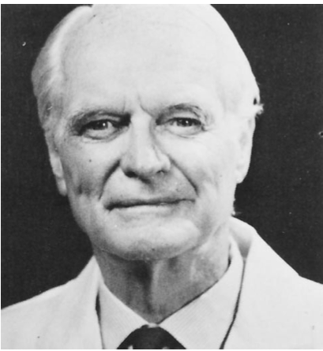
1930’s: Significant Clinical Accomplishments
Notes:
Developed the proper operation for constrictive pericarditis, doing the first pericardiectomy in 1928
Pioneer in thoracic surgical procedures for pulmonary embolism, bronchiectasis, tuberculosis, and cancer
He presented his results on his first 78 lobectomies for bronchiectasis at the AATS in 1936 and reported a mortality rate under 5% - the next best was Alexander at 18%
Pioneer in surgery of the parathyroid, performing the first mediastinal parathyroidectomy with Oliver Cope on Captain Charles Martell in 1932

Slide 15

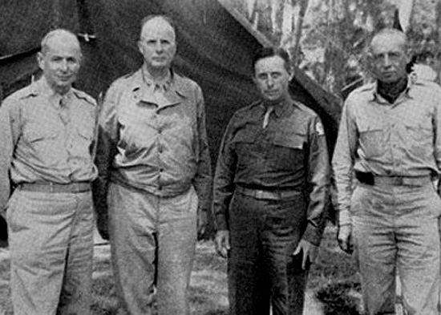
Colonel Churchill
Notes:
In Surgeon to Soldiers, Churchill identifies the beginning of his own involvement in WWII with a dinner of the Halsted Club in Philadelphia in Dec 1940.
A. N. Richards was the principal speaker and convinced all in attendance that the time had come to shelve long-range commitments in favor of the immediate situation about to confront the nation.
EDC, 1944, Surgical Consultant to the North African and Mediterranean Theaters.
Churchill made several great contributions to surgery, including:
Early debridement and delayed primary closure of wounds
Establishment of regional blood banks to encourage the use of blood transfusions and to prove that whole blood was more efficacious under battle conditions than saline or plasma
Improved the process of air evacuation of wounded soldiers

Slide 16
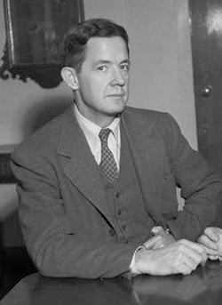
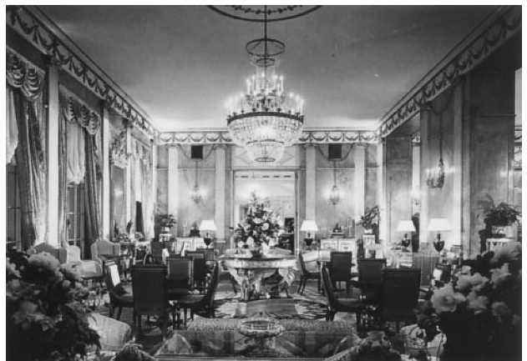
Excelsior Surgical Society
Notes:
This society was the product of military surgery in WWII, as surgeons would meet to exchange ideas, frequently at the Excelsior Hotel in Rome.
The society was established to honor Churchill, who would become the one and only honorary member.
Initial meeting in Boston in 1946.
The Society established a Churchill lecture, first given by Alfred Blalock.
Now a memorial lecture at the ACS – first given by Dean Warren from Emory.

Slide 17
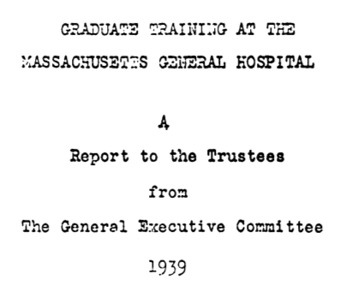
Churchill ED. Graduate training at the Massachusetts General Hospital:
a report to the trustees from the general executive committee. Boston; 1939.
Notes:
At MGH by 1935, surgical training had increased to 3 years, but the young surgeon was still not prepared for independent practice, unlike the single resident who did reach the apex of the Hopkins pyramid.
After the establishment of national standards for complete surgical training by the new ABS in 1937, EDC, in a second transformational point, with a major revision in the philosophy of surgical education in the US, formulated a “rectangular” program of residency to provide complete training to a smaller number of candidates, emphasizing peer group education in a school of surgery, not dominated by a single individual.
Churchill did not quarrel with the need for educational principles of the Halsted system: namely, knowledge of basic science, research, and progressive patient responsibility.
His criticism was directed toward the framework of the Halsted system, such as its indefinite length, competition for the single resident position, and one chief of service.
At the MGH, EDC tried to perpetuate the school concept of a group of masters, in which no single personality dominates the methods and the technology of the institution.
He further wished to obviate the subservient status of the trainee under a quasi-parental, self-aggrandizing, and authoritarian tutelage, which was so much a part of an apprenticeship.
We don’t want a man to be trained under a single master, for therein lies a danger.
His vision of a pattern for such a surgical school found expression in what was called “the Churchill Plan”, presented to the trustees of the MGH in 1939.
EDC recognized an institutional obligation to trainees. “The hospital has a grave responsibility to give the trainees the best that it has.”
Needless prolongation of training was to be avoided.

Slide 18
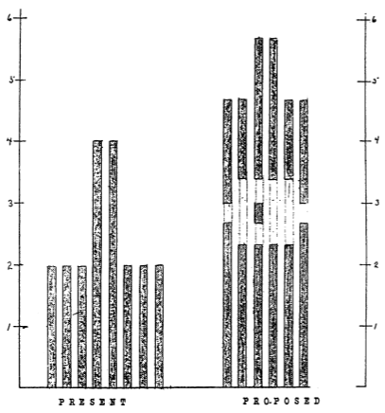
Churchill ED. Graduate training at the Massachusetts General Hospital:
a report to the trustees from the general executive committee. Boston; 1939.
Notes:
EDC proposed a solution in a rectangular program of surgical education, moving from the present model of 8 trainees who stay for 2 years and then only 2 allowed to progress for 2 more years – a sharply fashioned pyramid.
The new rectangular program, begun in 1940, selected 6 candidates but offered all of them complete surgical training, initially 4.5 years, quickly modified to 5 years.
The selection process was key, as all were expected to finish the program.
In the early years, virtually all of the interns were from HMS, but today it is a much more diverse group.
Two were offered a further supervisory year of education (chiefs of the East and West services), which might provide preparation for an academic post.
Gaps indicate possible elective periods.
This rectangular program removed the constant competition for survival and allowed the residents time to focus on their education, working cooperatively with other members of his peer group.
EDC believed that both future professors and practitioners required similar surgical education in depth.
He often stated that he was as proud of his graduates who were practicing surgeons in a community as he was of those who became professors.
Implementation of this plan was largely deferred by the onset of WWII.
The entering class of 1946 was the first to move through the new system completely in accordance with the plan.
Upper echelons of the residency staff were filled by returning veterans, but the essence of the program had changed.

Slide 19
Churchill’s Principles of Training
Exploitation of the intern was to be avoided
    “Prolonged routine work dulls the imagination”
Exposure to basic science
“Others desiring to attain excellence as practitioners of
  surgery will not be required to do penance in experimental
  laboratories in order to secure advanced clinical training”
3. Flexibility was to be sought
“A frozen five-year curriculum . . . is unthinkable as it allows
no latitude for the development of individual interests and
proficiencies”
Churchill ED. Graduate training at the Massachusetts General Hospital:
a report to the trustees from the general executive committee. Boston; 1939.

Slide 20
Churchill’s Principles of Training
A devoted surgical staff
Staff appointments were to be “held by mature and well- qualified surgeons, willing to devote time and effort to the training of residents”
5. Graded responsibility
Responsibility of the trainee must be increased “as the individual proves himself competent to take it on his shoulders”
Churchill ED. Graduate training at the Massachusetts General Hospital:
a report to the trustees from the general executive committee. Boston; 1939.

Slide 21
Churchill’s Principles of Training
Advisory board for surgical education
To avoid “cumulative warping of the structure of the educational program” by “a series of minor changes, each judged in what is immediately expedient for . . . the convenience of the administrative or professional staff”¹
Autonomy
“He gave his residents great responsibility, particularly in the operating room. In his opinion, the visiting surgeons should serve as consultants and called by residents only at the residents’ option”²
¹Churchill ED. Graduate training at the Massachusetts General Hospital:
a report to the trustees from the general executive committee. Boston; 1939.
²Welch CE. In: A Twentieth-Century Surgeon: My Life at the Massachusetts General Hospital. Boston, 1992.

Slide 22
Consequences of the “Churchill Plan”
Succeeded in giving complete training to superior surgeons
Eliminated the human wastefulness of the pyramidal system
“Half a surgical training is about as useful as half a billiard ball”
3. Responded to the nation’s surgical needs after WWII
Grillo HC. Surgery 1999;136:947-952.

Slide 23
Consequences of the Churchill Plan
Churchill was not one of the original members of the ABS founded in 1937
Close friendship with Evarts Graham meant that many of his ideas were incorporated into the planning of the ABS
The Halsted system had revolutionized surgical education 50 years previously, but surgical and societal needs were now better met by the rectangular model
The pyramidal system was soon abandoned by most programs in favor of the rectangular model, which is the model for all residency programs today
Grillo HC. Surgery 1999;136:947-952.

Slide 24
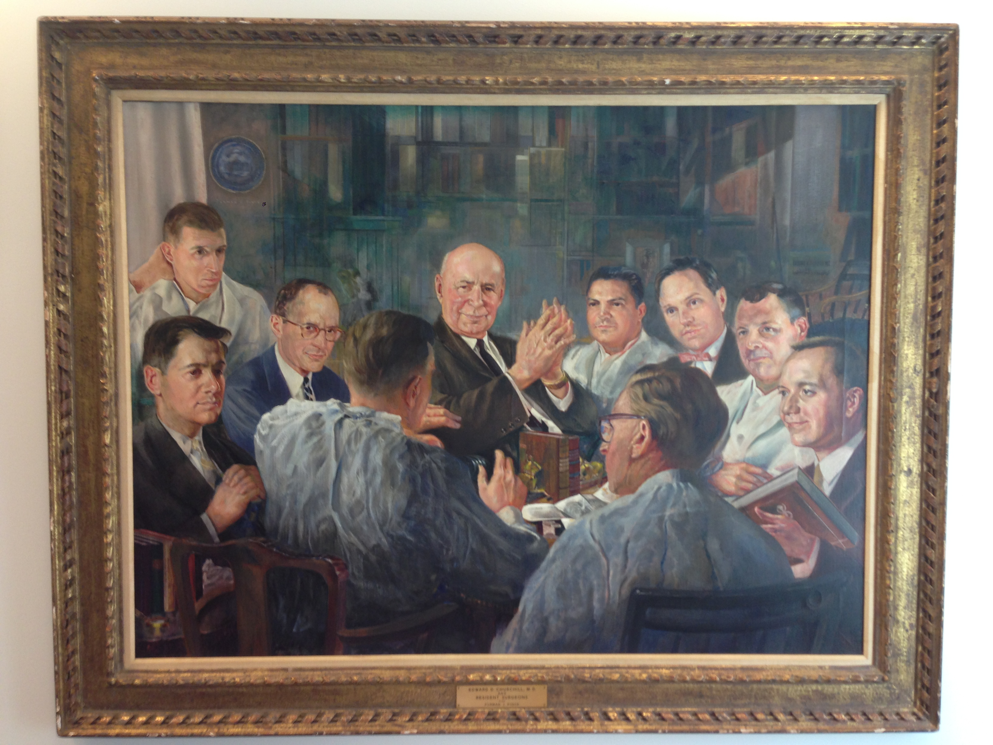
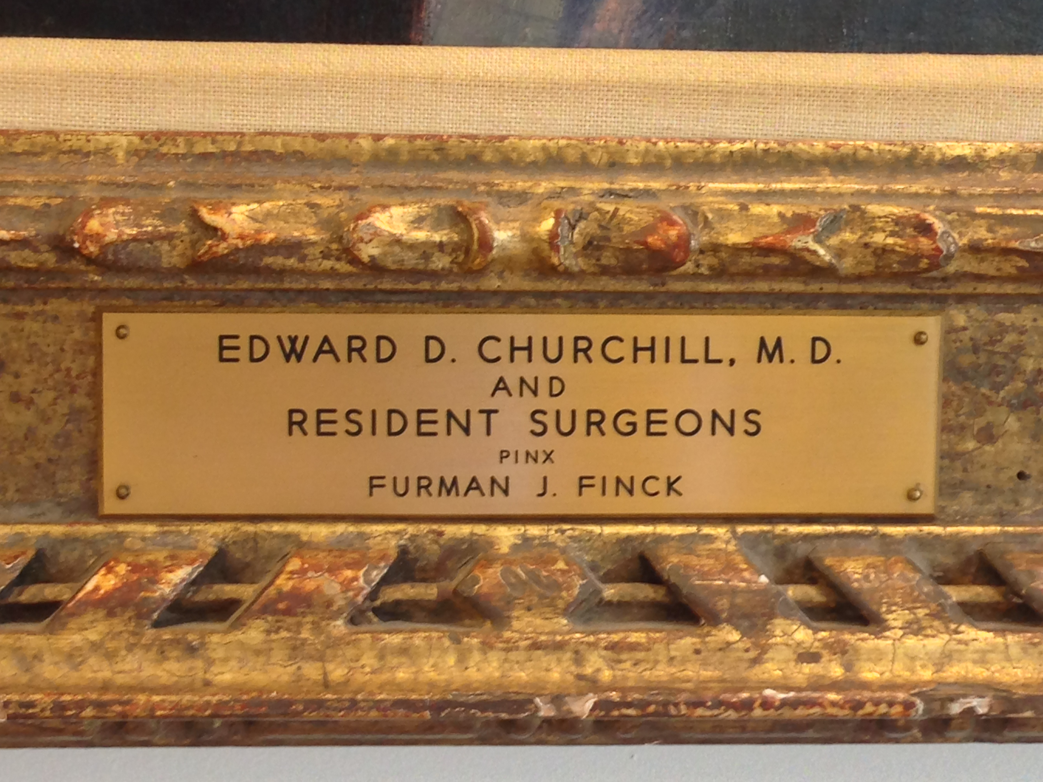
Notes:
Churchill teaching the residents – perhaps his favorite activity.
This painting hangs in WGA’s office, the Distinguished Edward D. Churchill Professor of Surgery at HMS.
Churchill was prescient, as his principles are those enumerated by the ACGME, and his concerns about the importance of broad knowledge and training in general surgery prior to specialization rings true today.
As we adapt to all of the changes taking place in surgical education today, we would all do well to remember the fundamental educational principles of Halsted and Churchill and the evolution that brought us to this point.
The most important principle that we must never let slip is our commitment to the educational needs of our students, who shall be our successors, and to the best interests of our patients, whom we both serve.
Edwin Salzman, Henry L. Edmunds, Ronald Malt, Dr. Churchill, Anthony Monaco, John Constable, Harold Urschel, and Charles Huggins, Jr.

