Slide 1
Horace Smithy
Pioneer Heart Surgeon
Fred Crawford, MD
September 2013

Slide 2
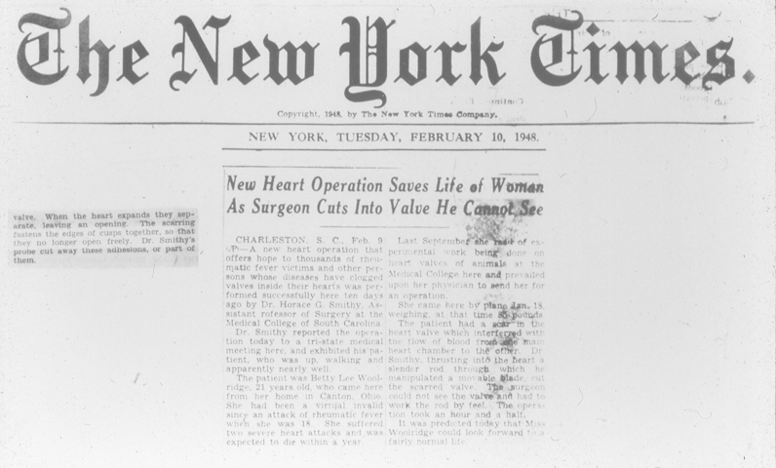

Slide 3
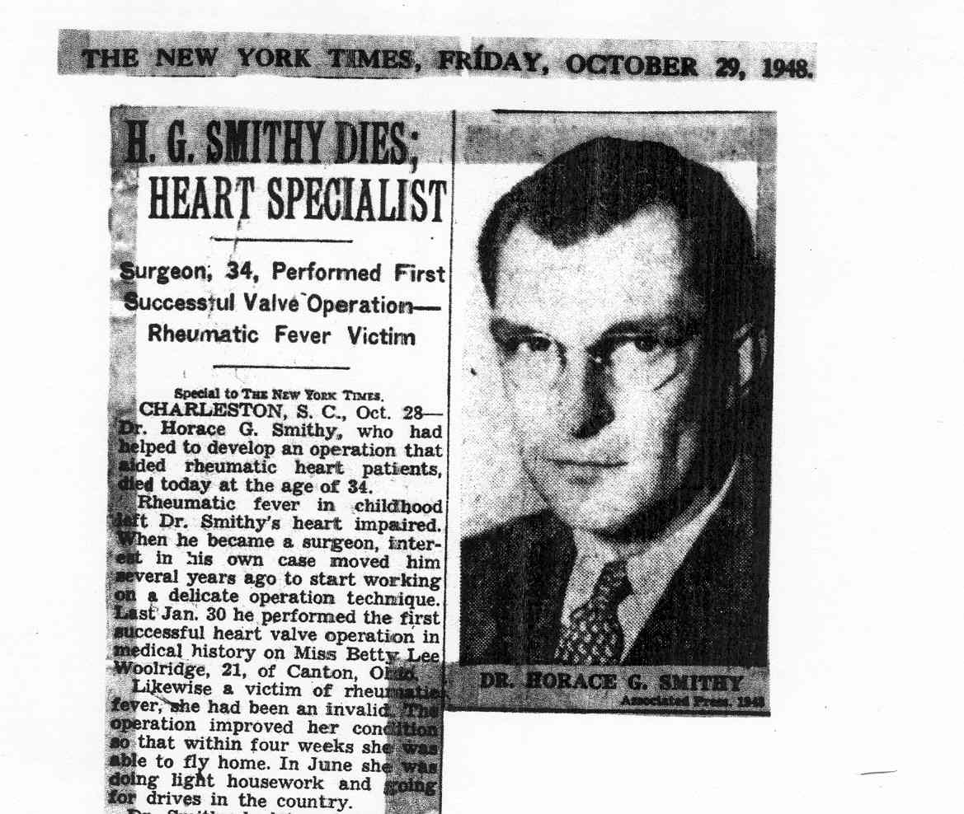

Slide 4
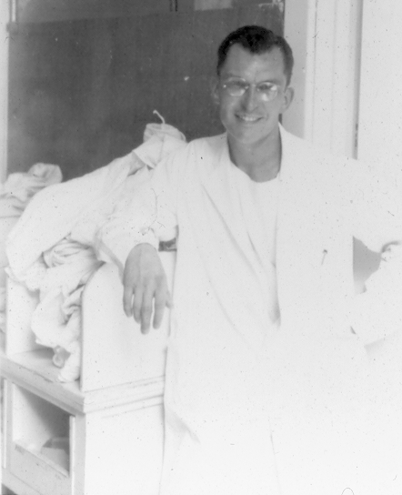

Slide 5
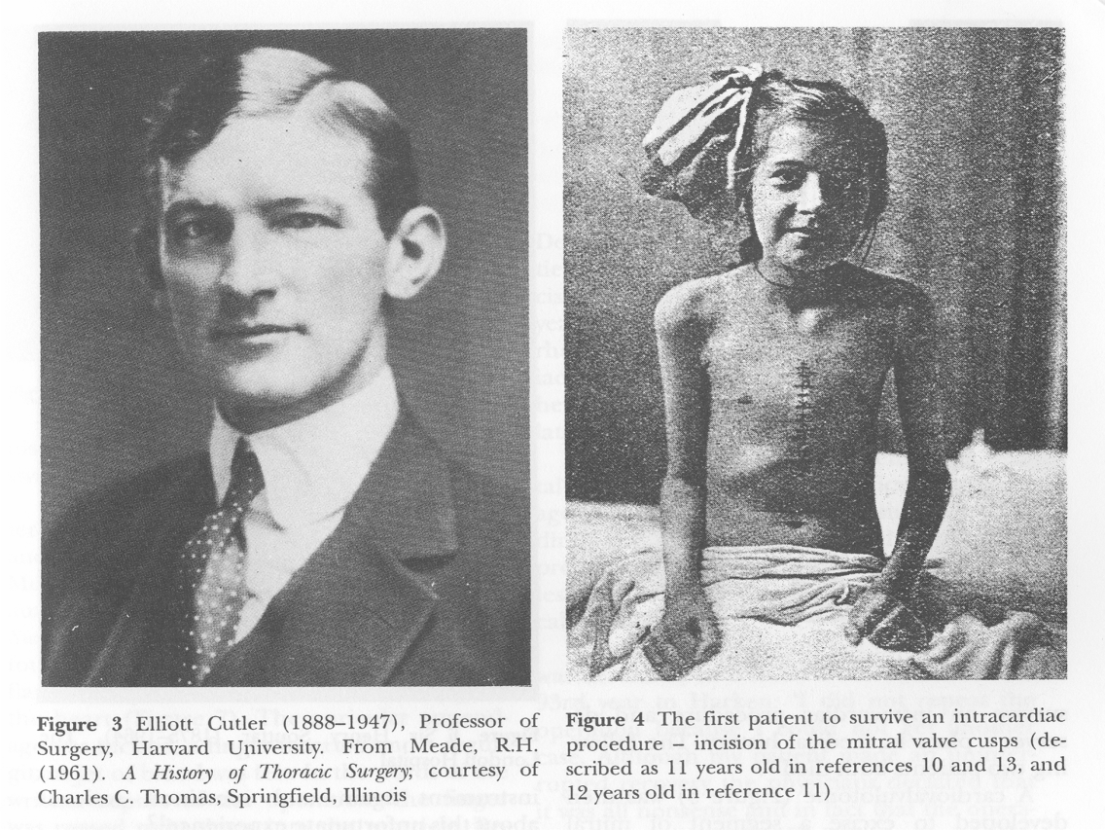
May 20, 1923
Elliott Cutler (Boston)
  successful mitral valvulotomy (knife) on 12 year old girl
  subsequent patients died of ↑ MR
  procedure abandoned

Slide 6
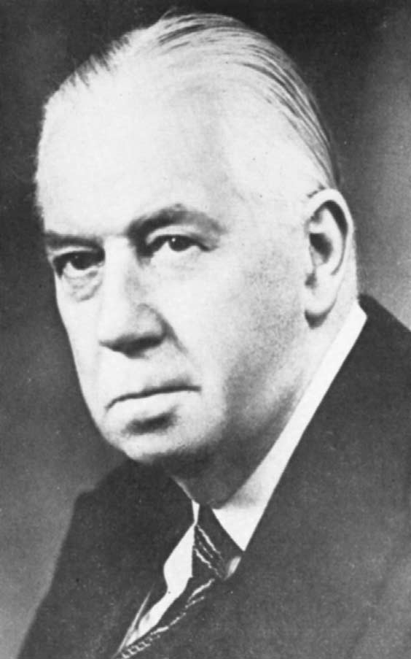
1925
Sir Henry Souttar (London)
  mitral valvulotomy (finger)
  no subsequent referrals

Slide 7
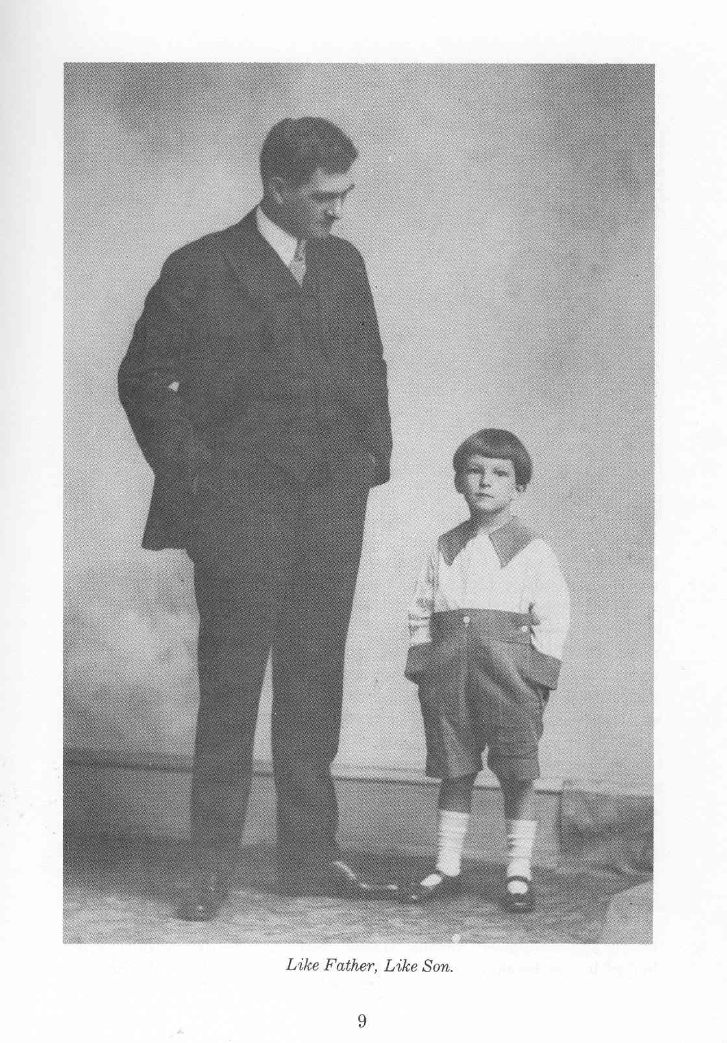
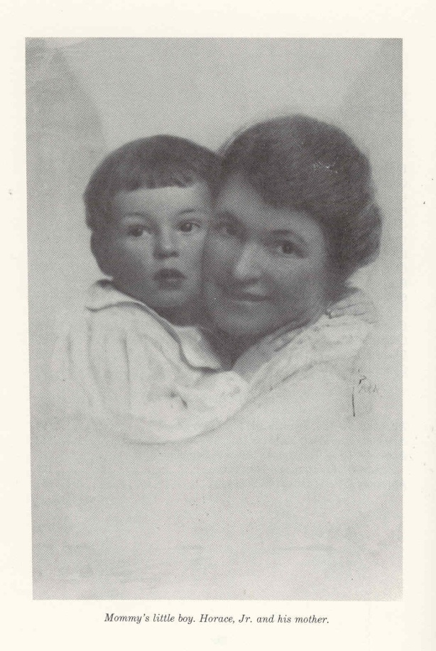
Horace G. Smithy
Born “blue baby” July 19, 1914 Norfolk, Virginia
Father originally from Marion, SC
Grew up in Washington, DC
Considered mother’s family estate “Rose Hill” in Berryville, VA as “home”

Slide 8
Education
Friends School (Washington) – 8 years
Episcopal High School (Alexandria, VA) – 2 years (sinus infections)
Miami Military Academy

Slide 9
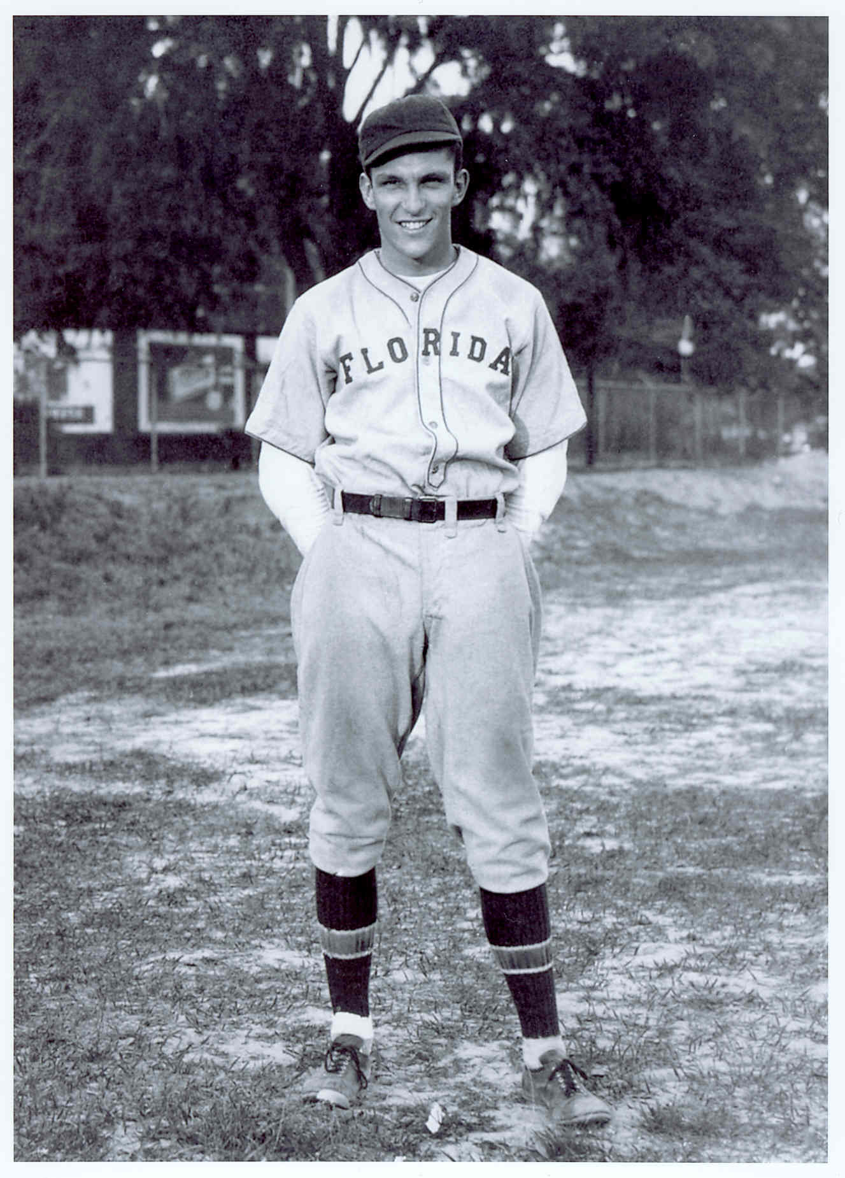
Undergraduate Education
University of Florida
  (football, baseball, boxing)

Slide 10
Medical Education
University of Virginia MD 1938

Slide 11
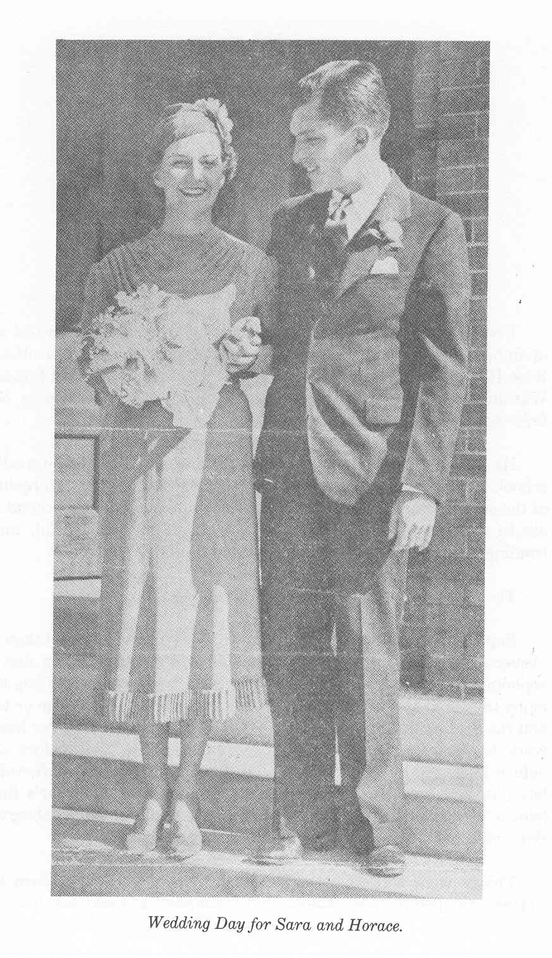
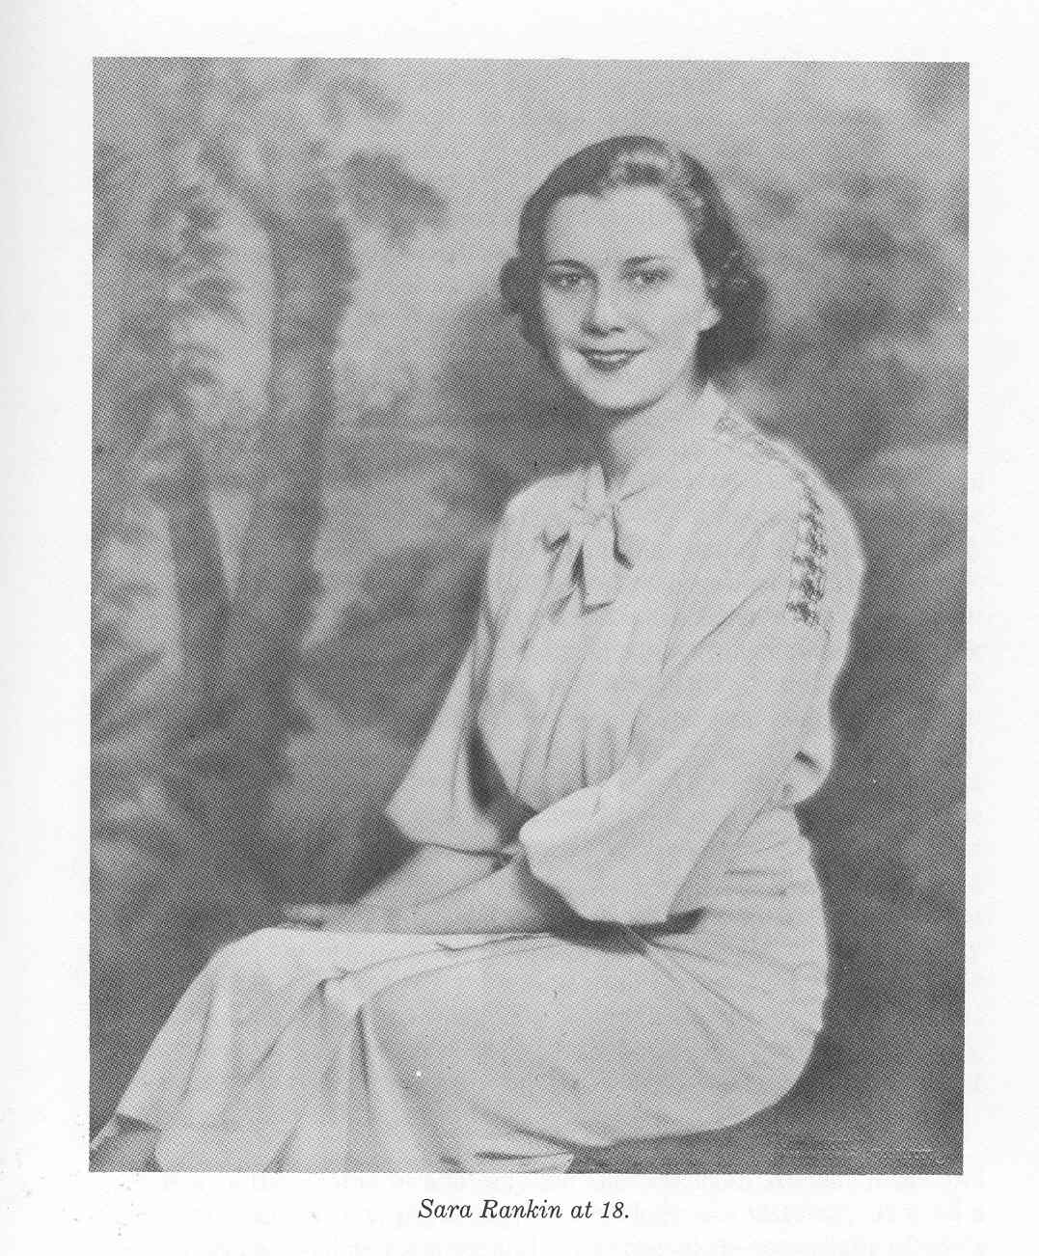
Family
Met Sara Rankin while at University of Florida (born in Columbia, SC; descendent of John C. Calhoun)
Married December 23, 1936

Slide 12
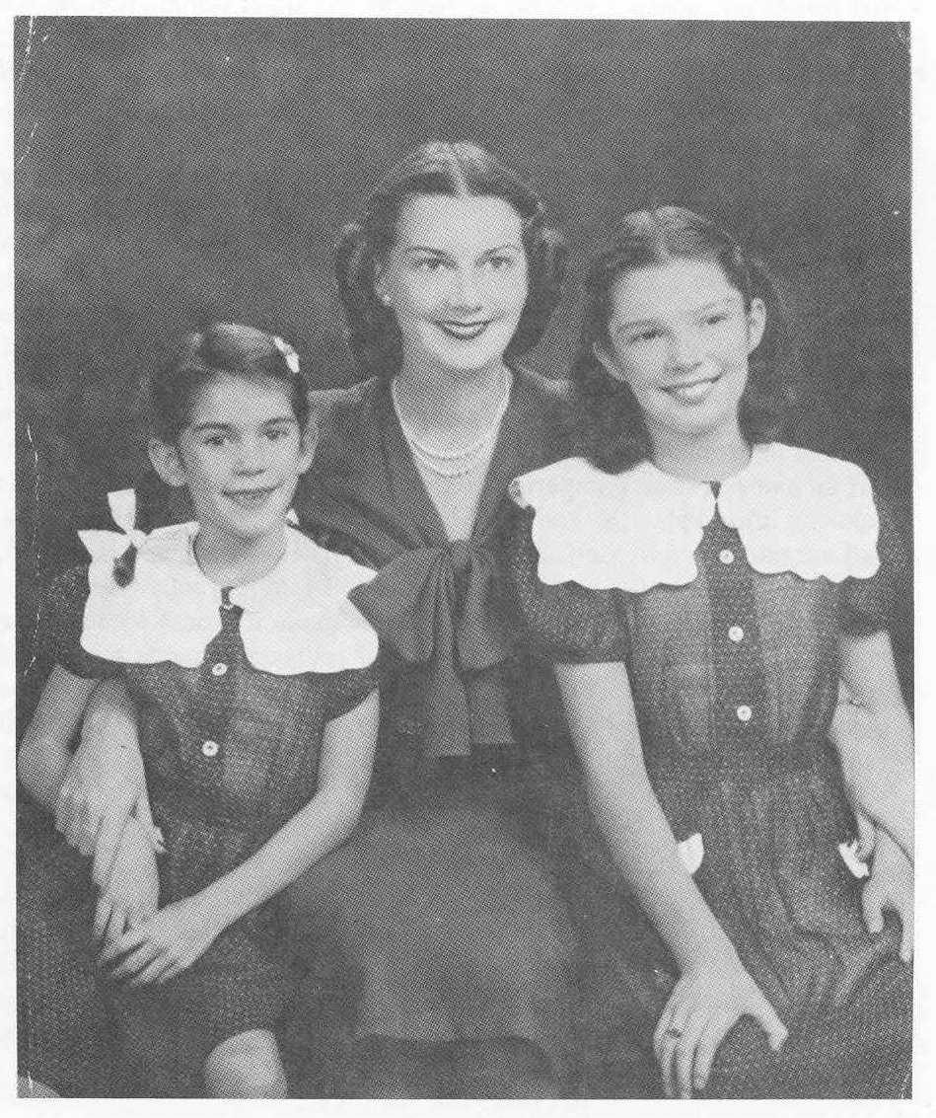

Slide 13
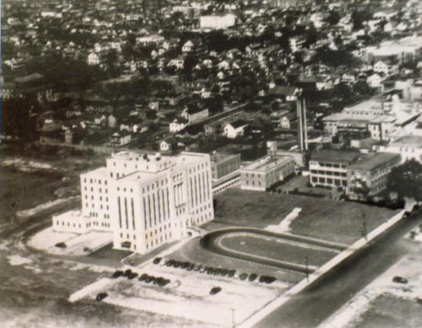
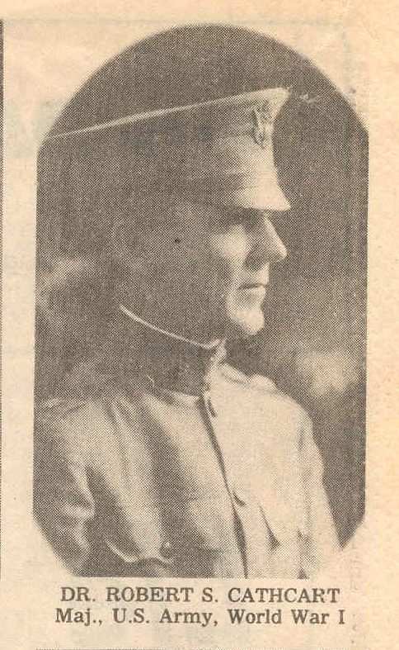

Slide 14
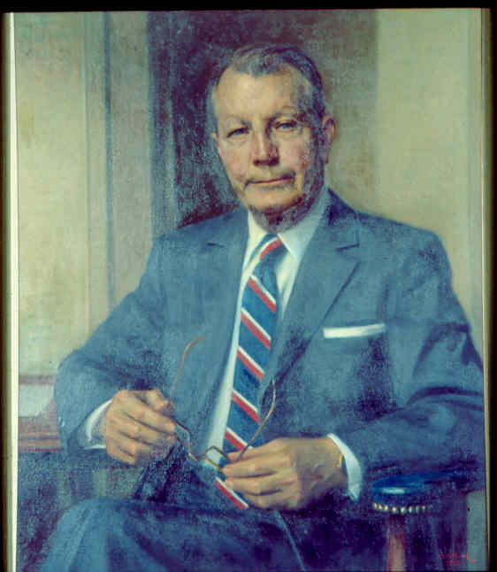
Professional Career
Appointed Assistant Professor of Surgery – MCSC (1942)
Worked in dog lab with Edward Parker
(Sixth president STSA)
Published 18 papers

Slide 15
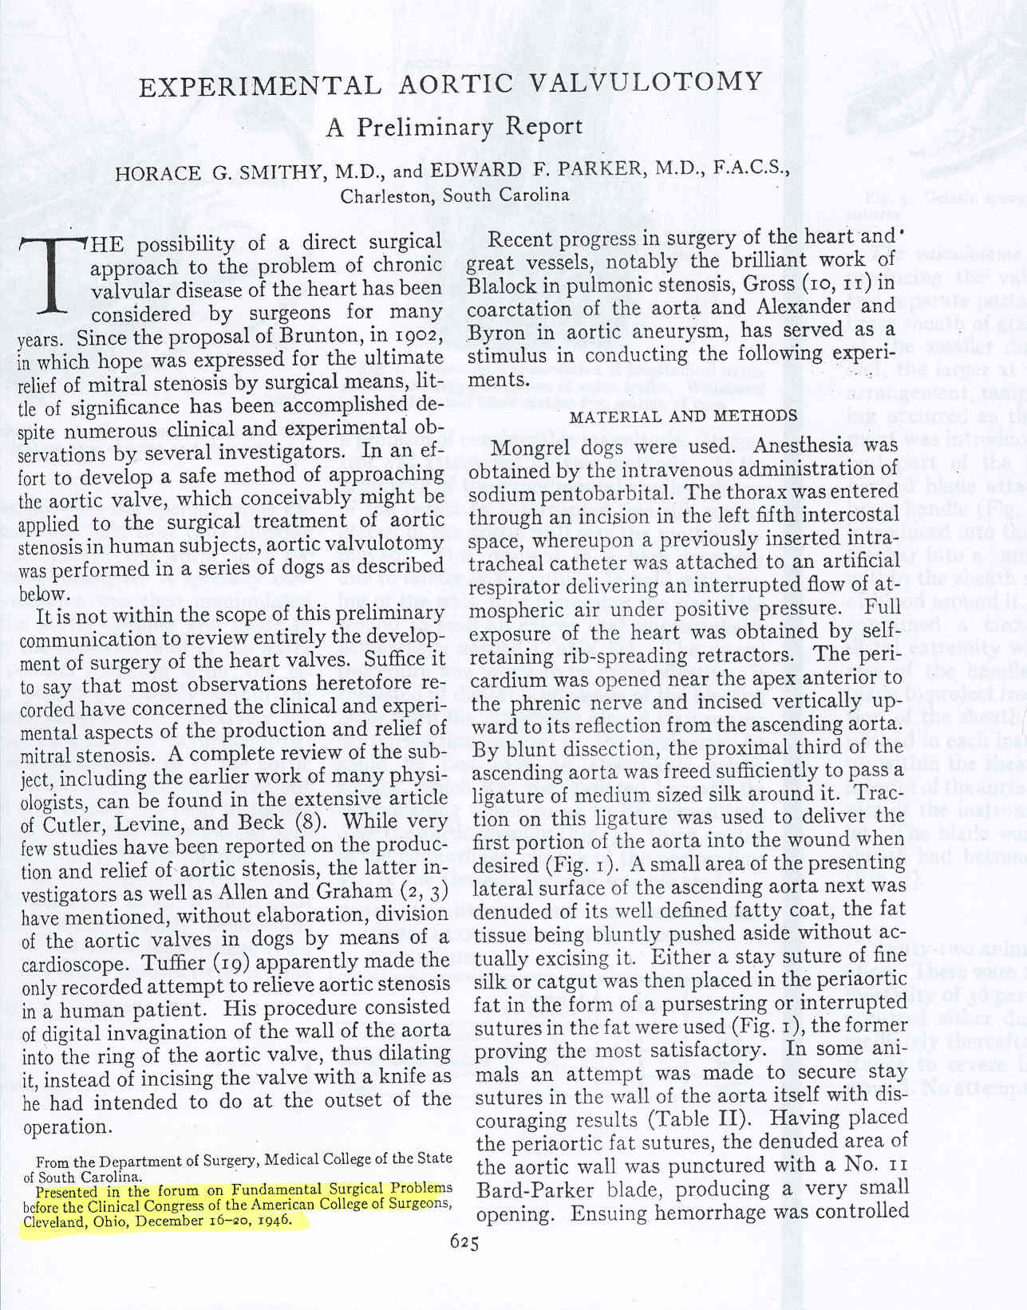
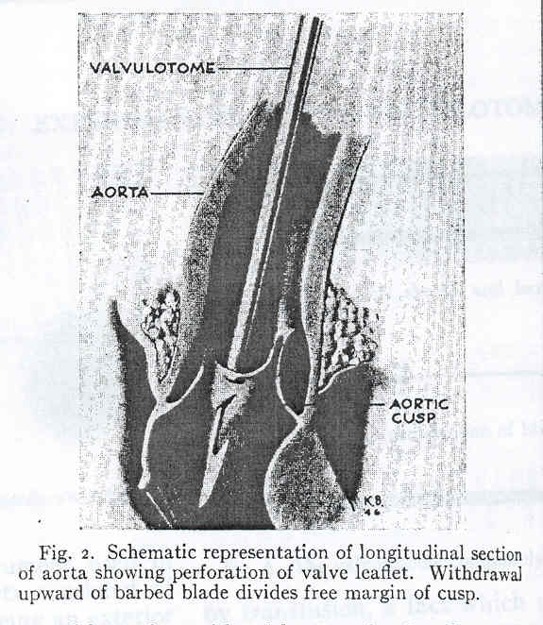

Slide 16
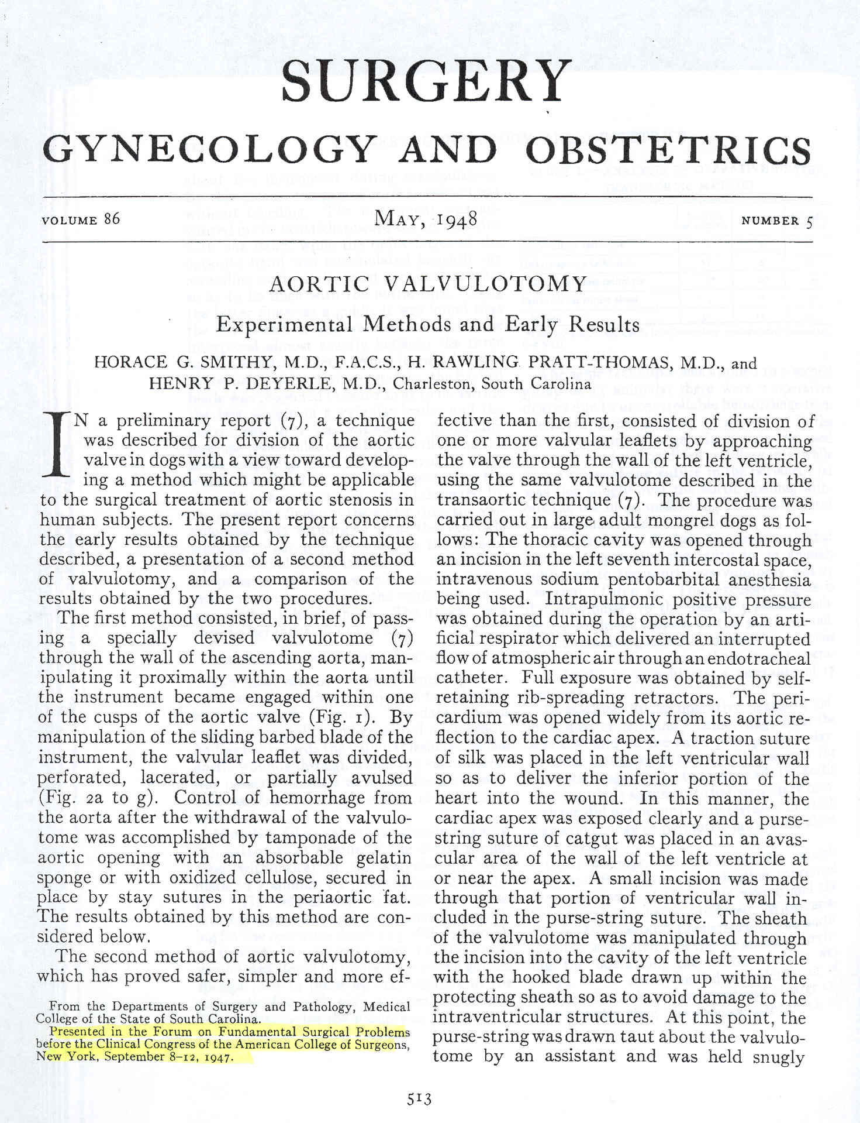

Slide 17
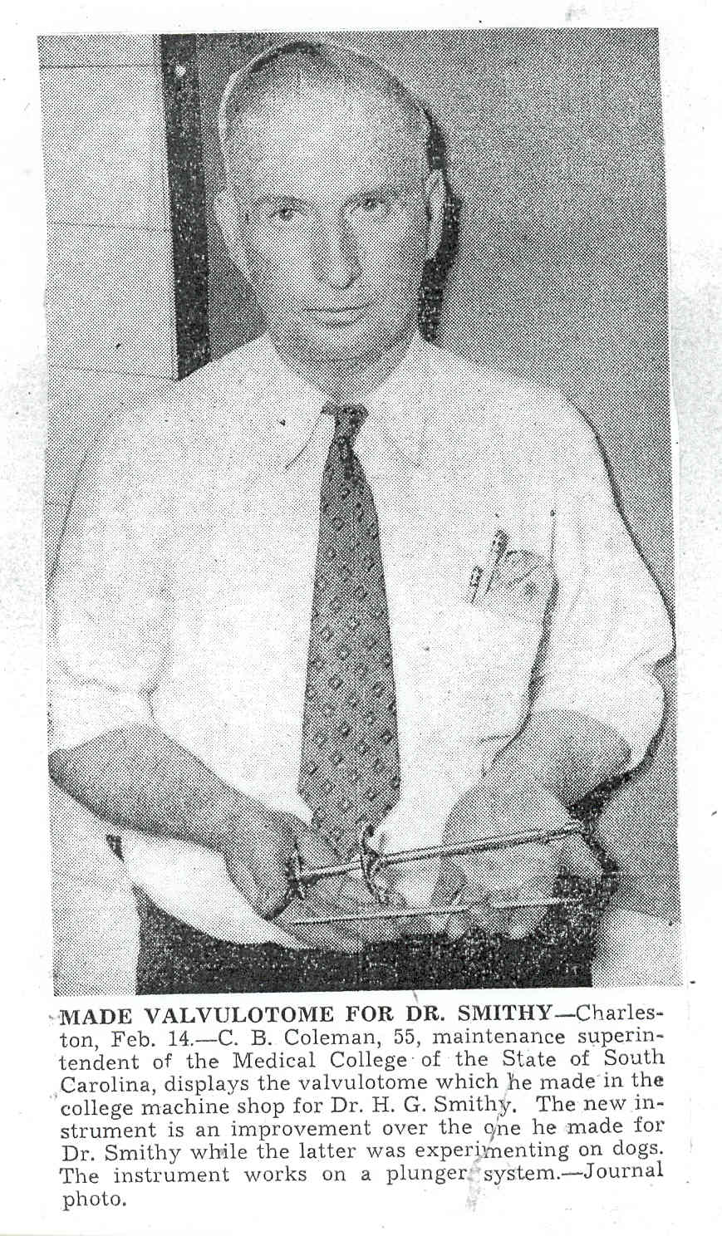

Slide 18
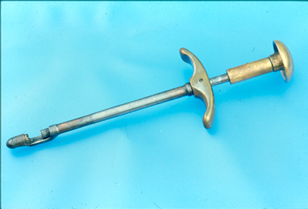

Slide 19
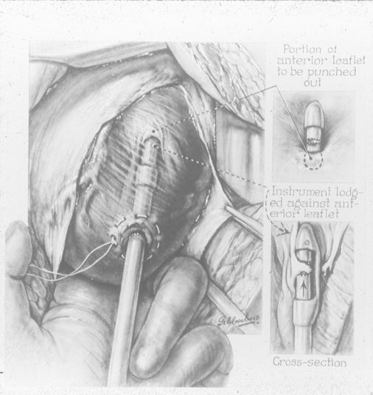

Slide 20
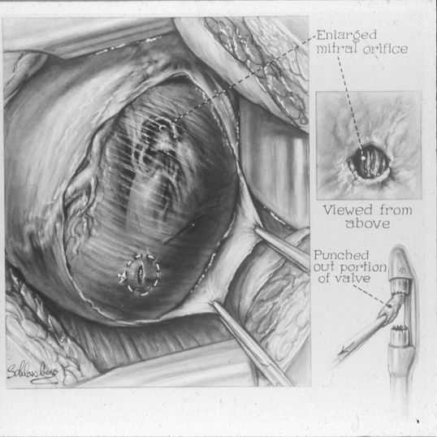

Slide 21
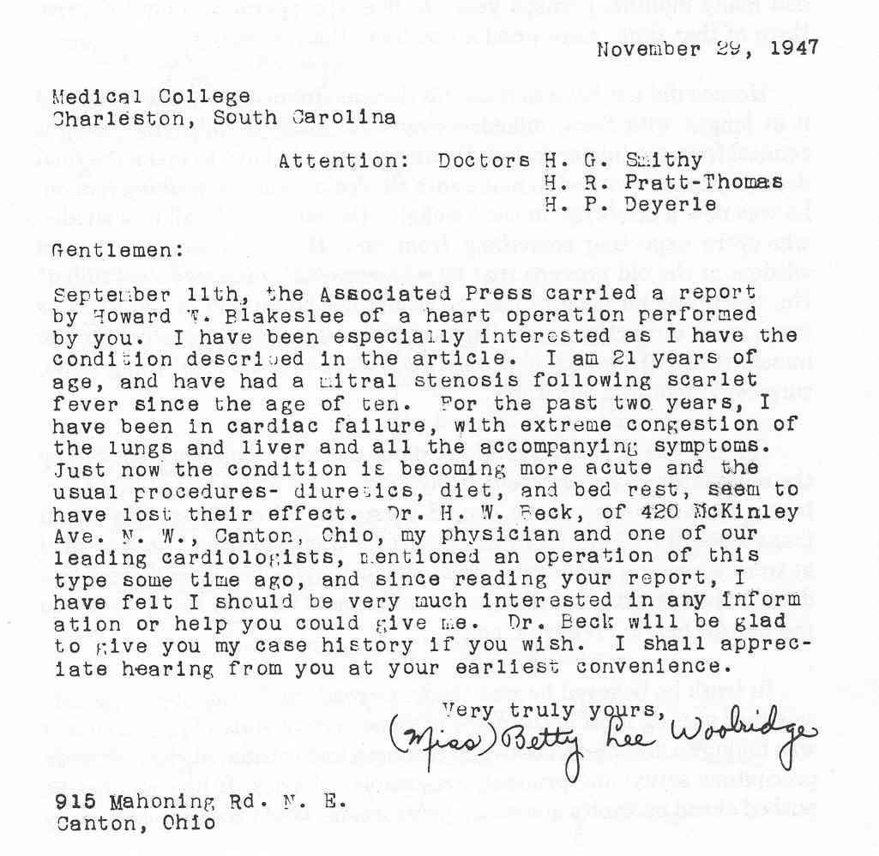

Slide 22
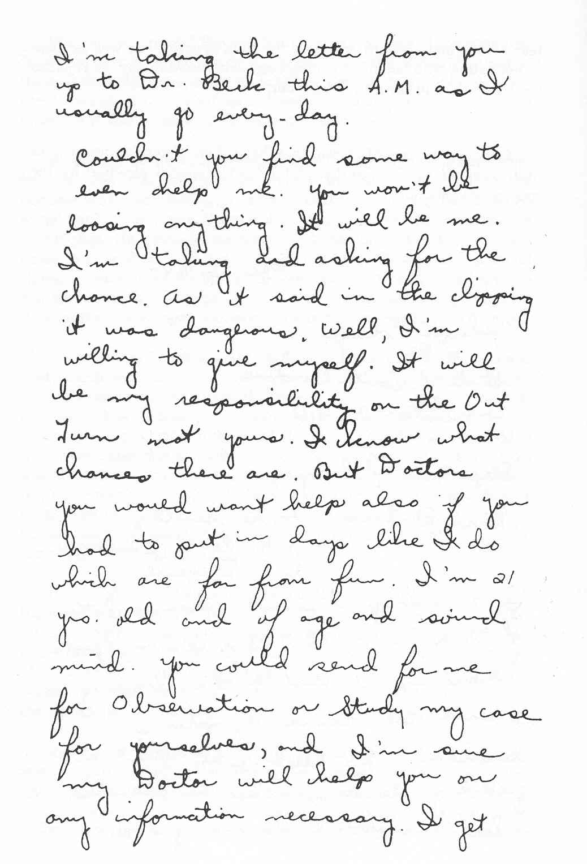
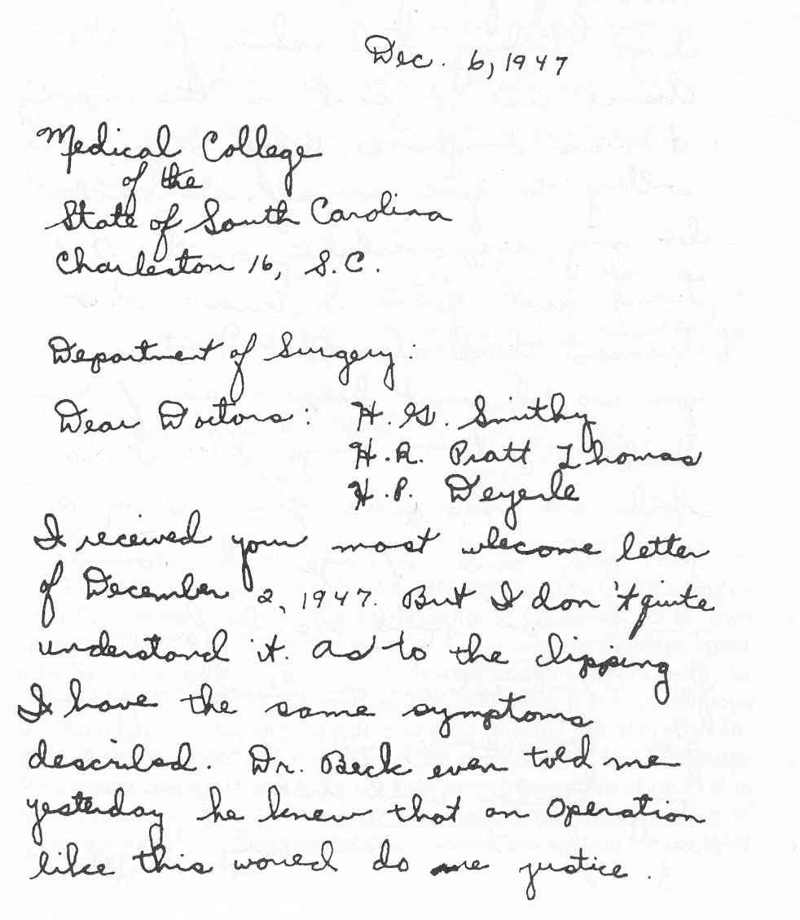
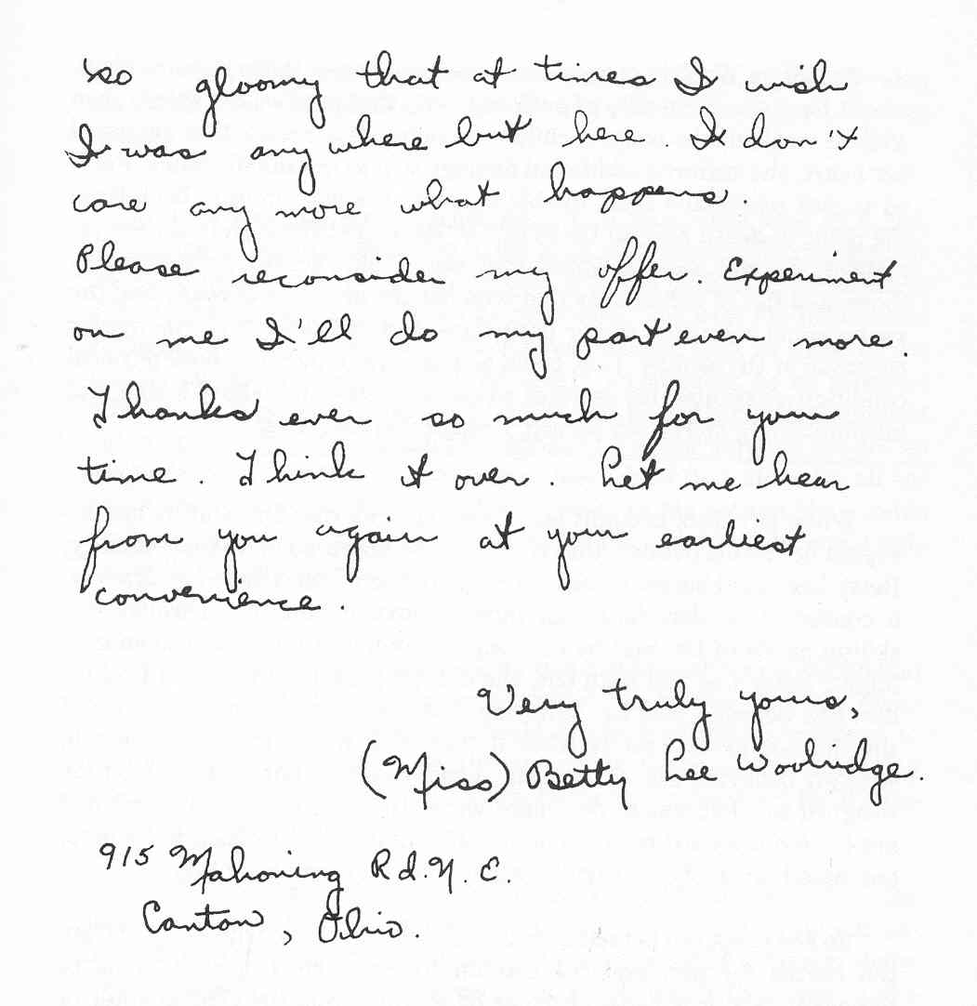

Slide 23
Dr. Smithy noted that “Betty presented with many
cardinal signs of chronic heart failure. The veins in
her neck stood out chord like; her abdomen was
distended by fluid accumulated there because
of congestion of the liver; the pressure within her
veins was 2 ½ times normal; she was unable to lie
down flat, but had to be propped on three pillows
in order to breathe with comfort. ”
The Heart of a Surgeon
John Kiley, 1984

Slide 24
“The operative procedure was without incident
and no change occurred in the character of the
Auricular fibrillation which was present during
the operation… Postoperative convalescence
was uneventful… Orthopnea disappeared entirely.
The liver became impalpable… Of interest was
reversion of the fibrillation by the third
postoperative day to normal sinus rhythm.”
The Heart of a Surgeon
John Kiley, 1984

Slide 25
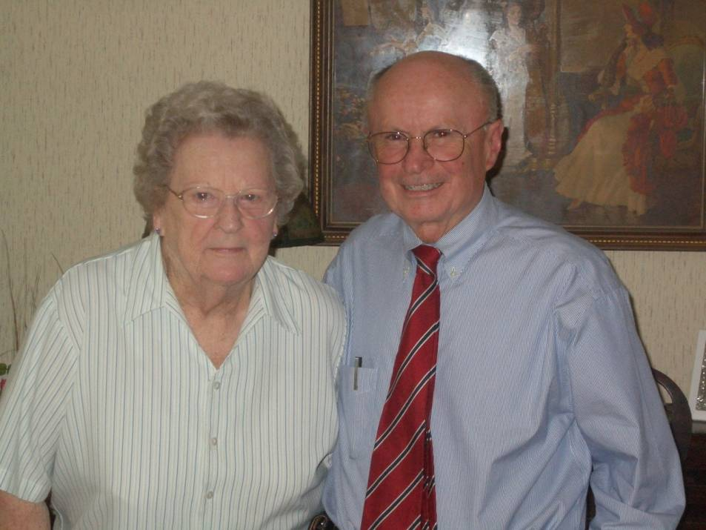
“She got on fine with the anesthetic, no trouble at all, and the operation didn’t take but an hour and 30 minutes.”
Interview with Agnes Kleckley, RN, 8/27/2008
Fred A. Crawford, Jr., M.D.

Slide 26
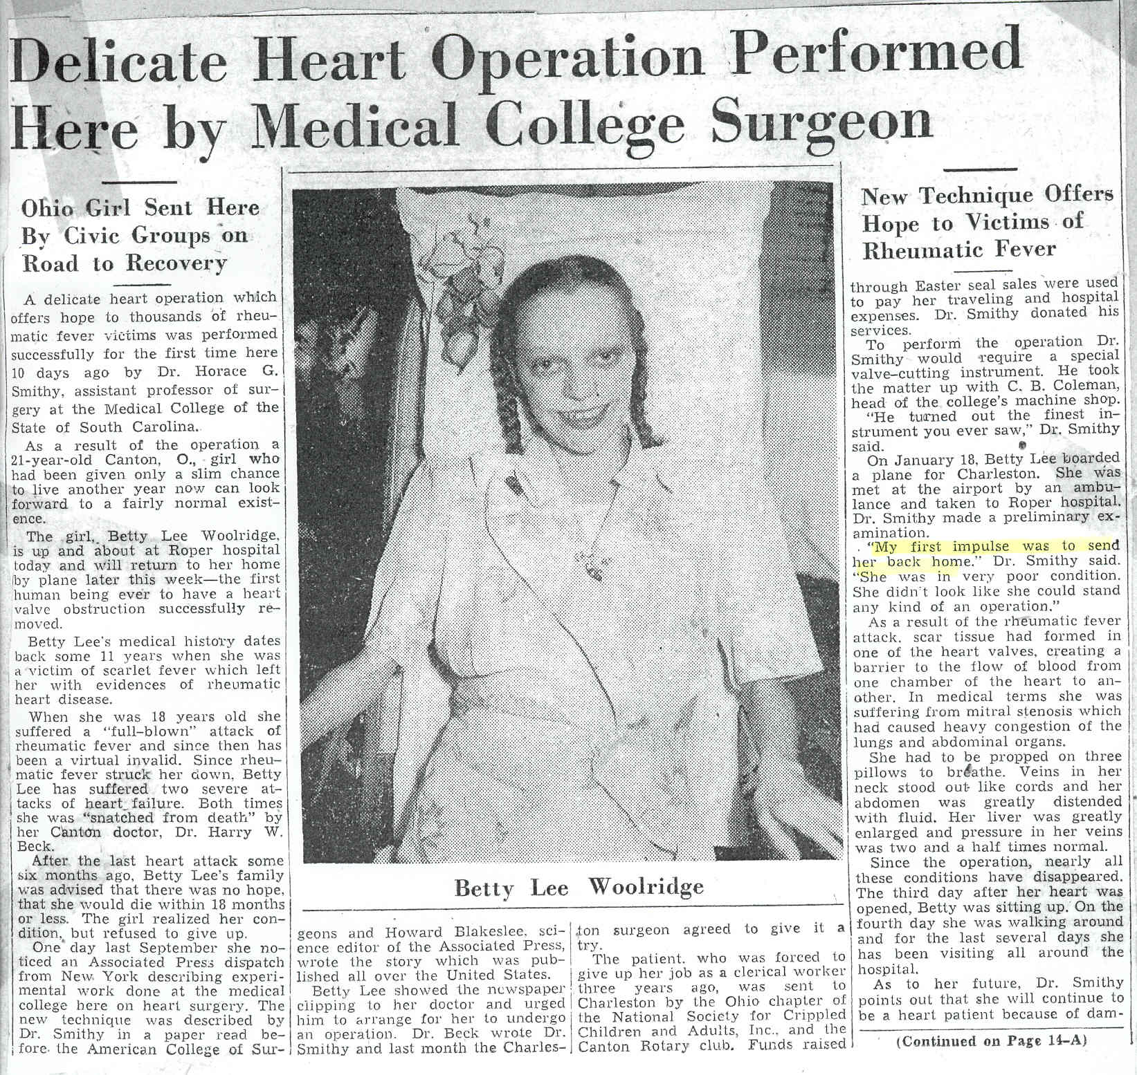

Slide 27
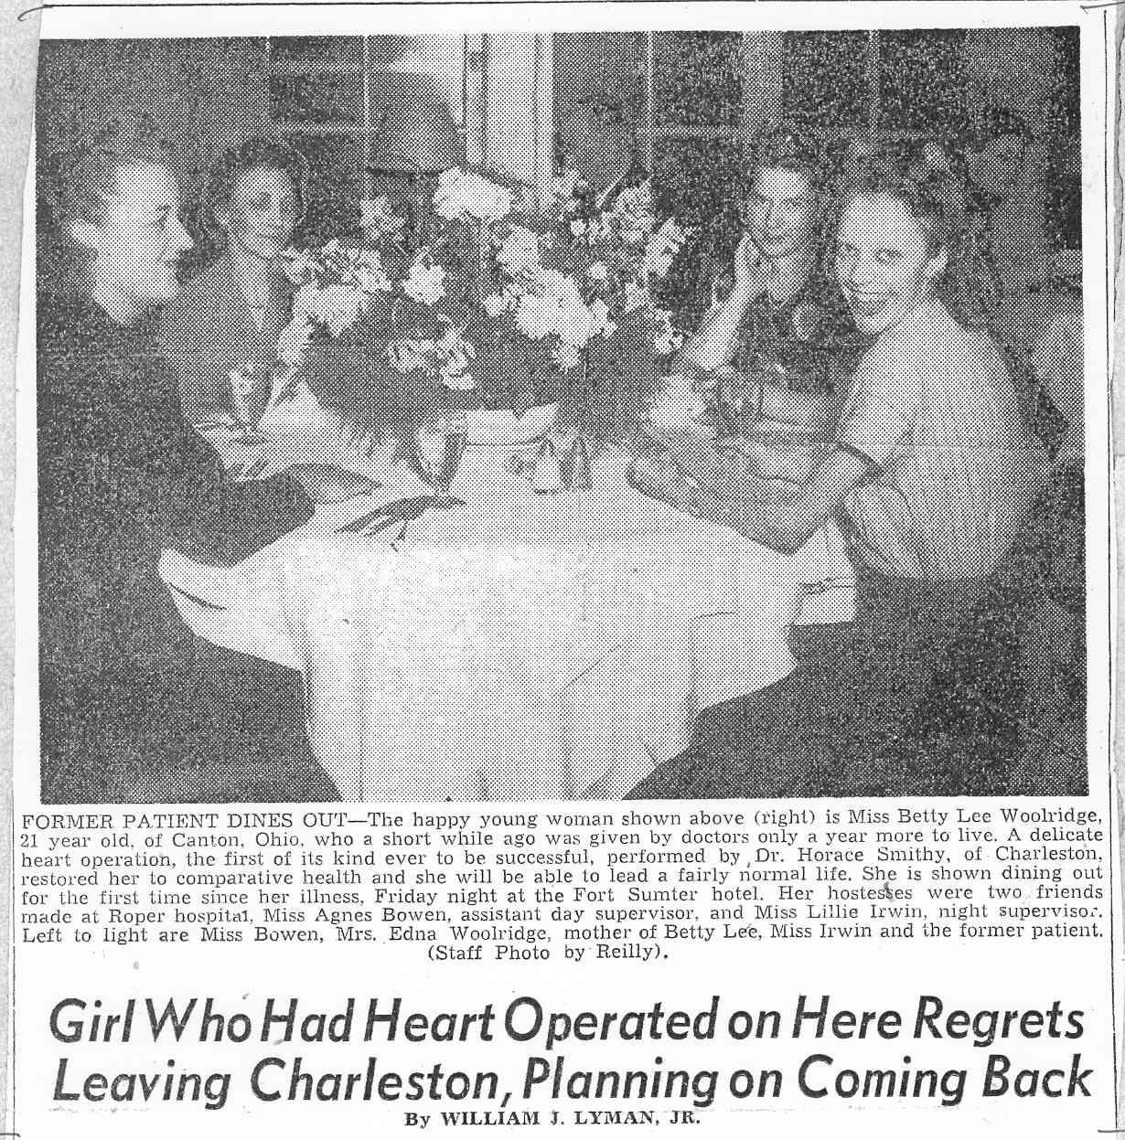

Slide 28
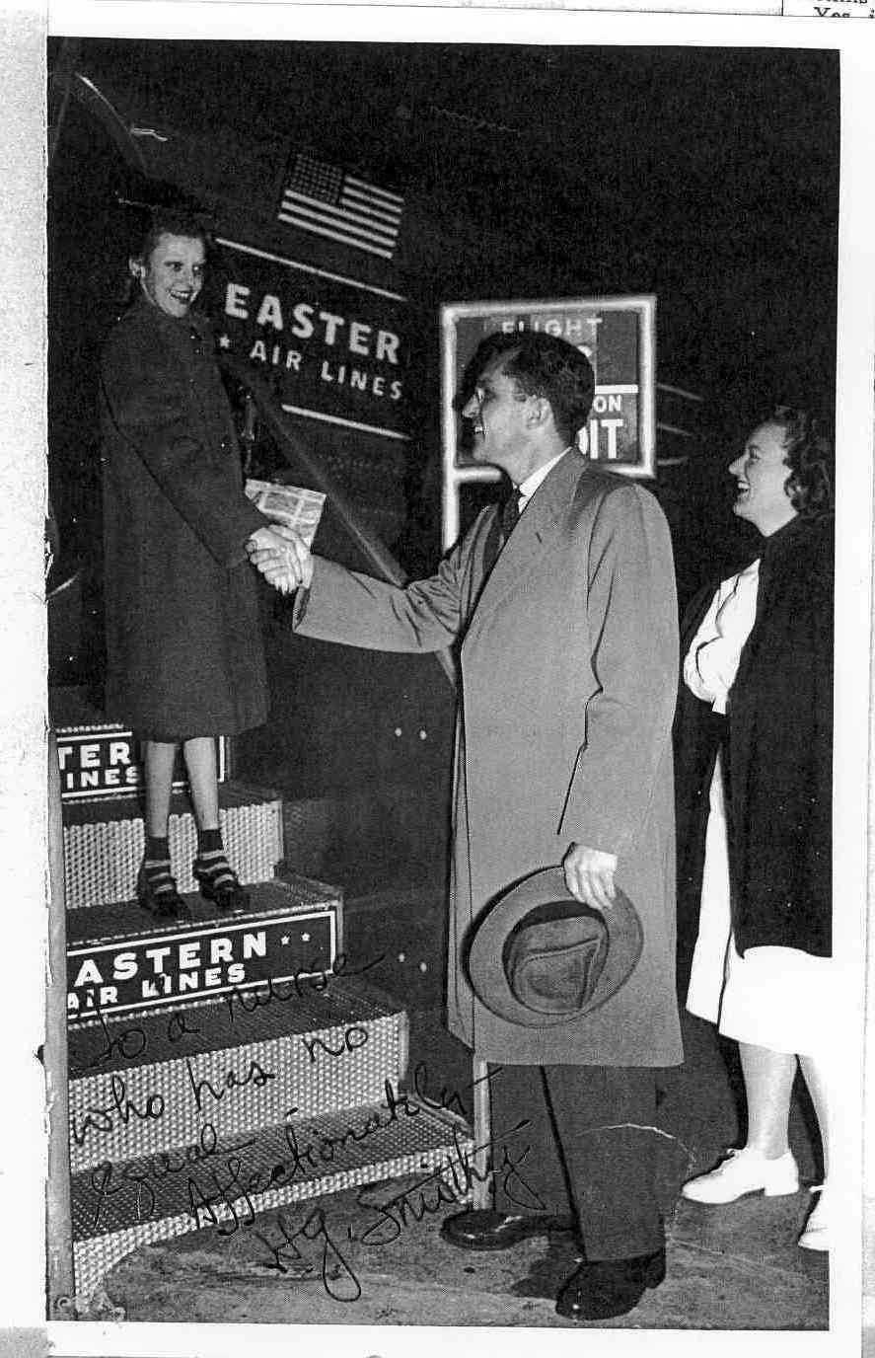

Slide 29
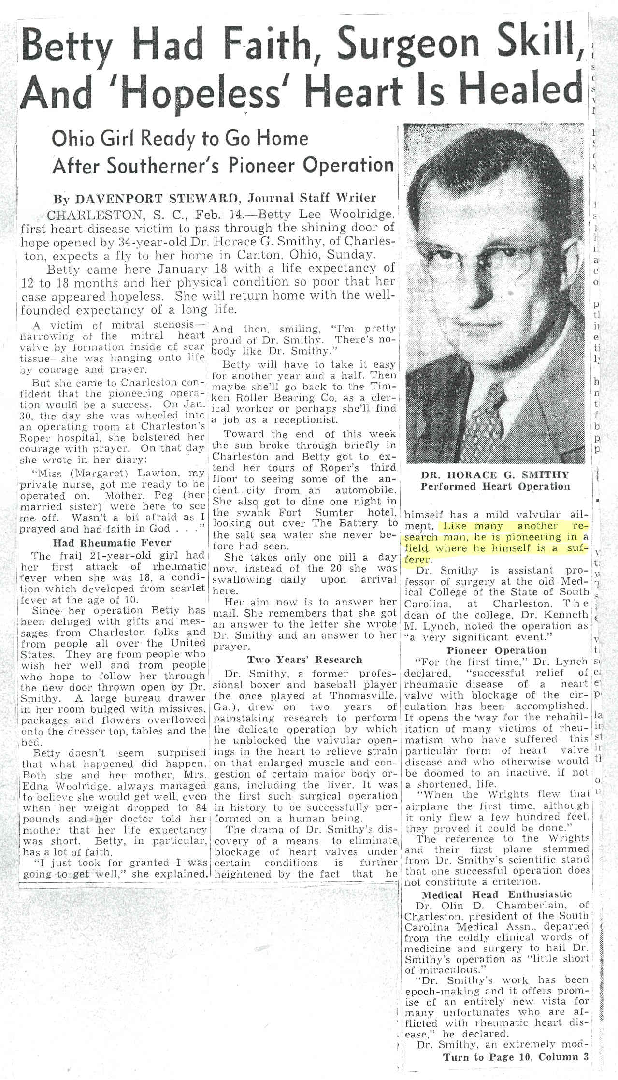
“ Like many other research men, he is pioneering in a field where he himself is a sufferer.”

Slide 30
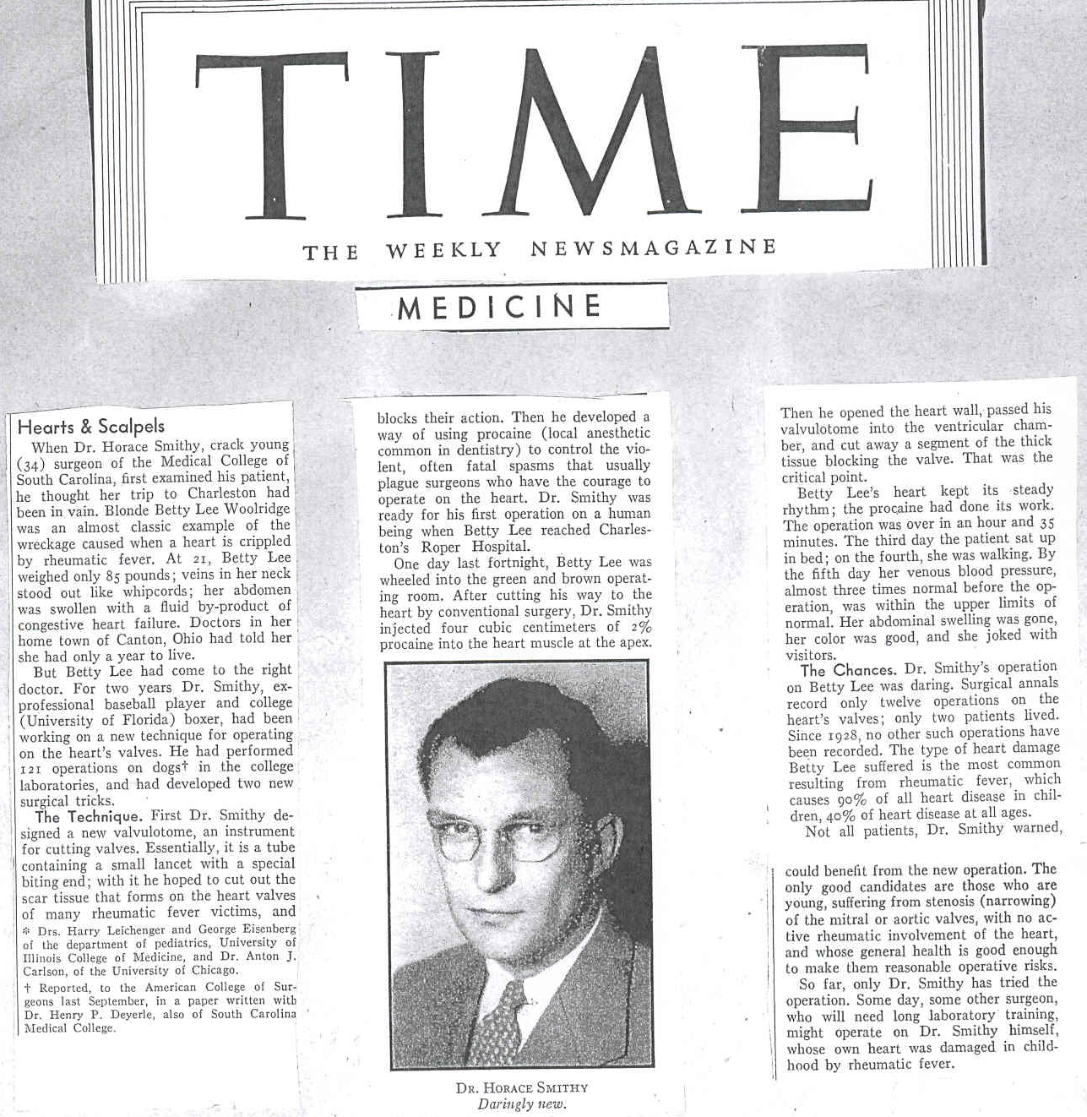
“So far, only Dr. Smithy has tried the operation. Some
day, some other surgeon, who will need long laboratory
training, might operate on Dr. Smithy himself, whose
own heart was damaged in childhood by rheumatic fever.”
Time, February 16, 1948

Slide 31
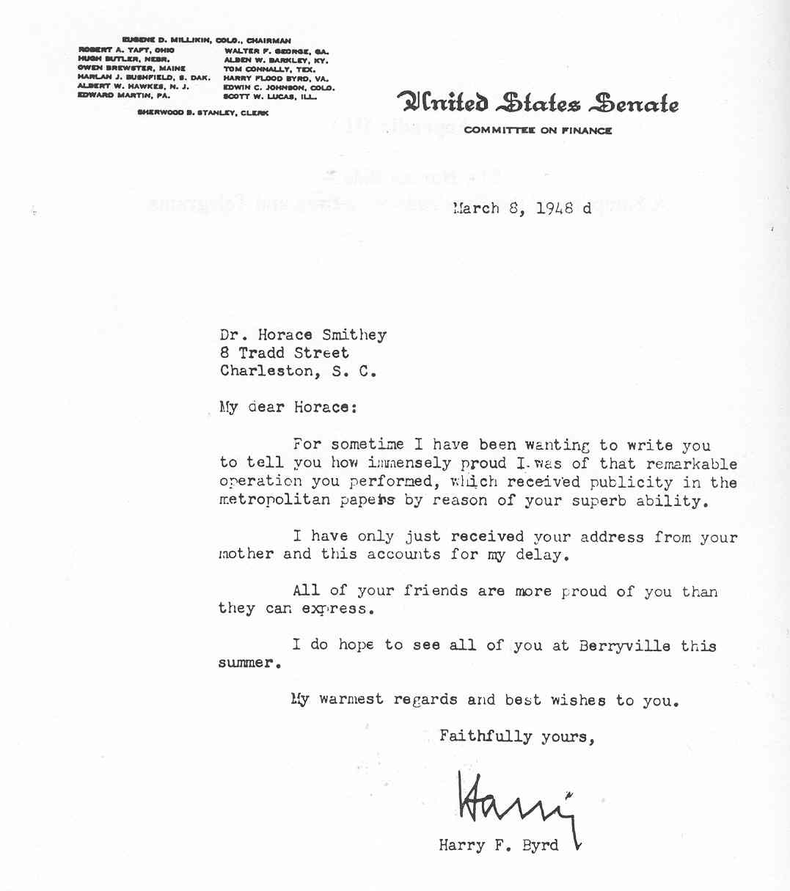

Slide 32
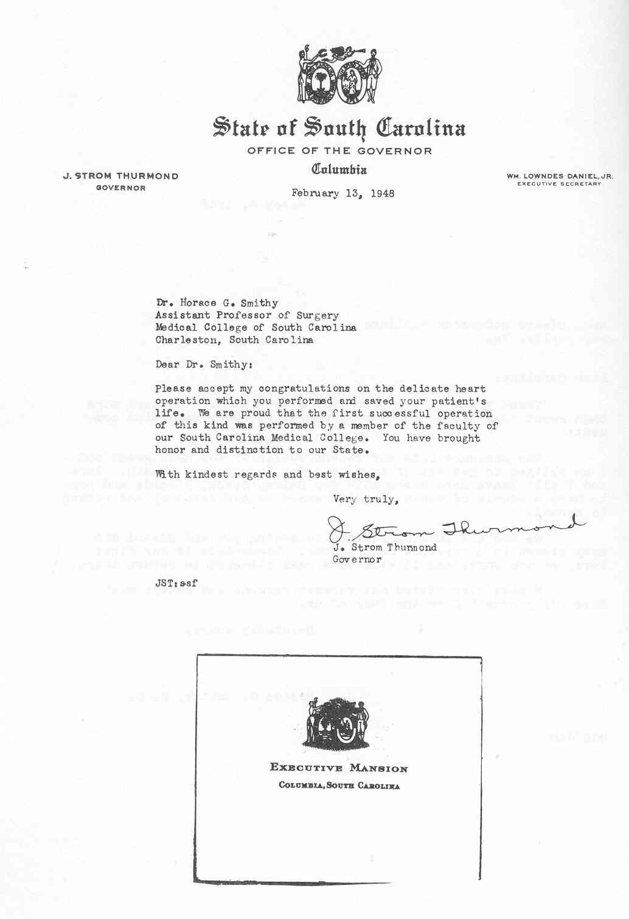

Slide 33
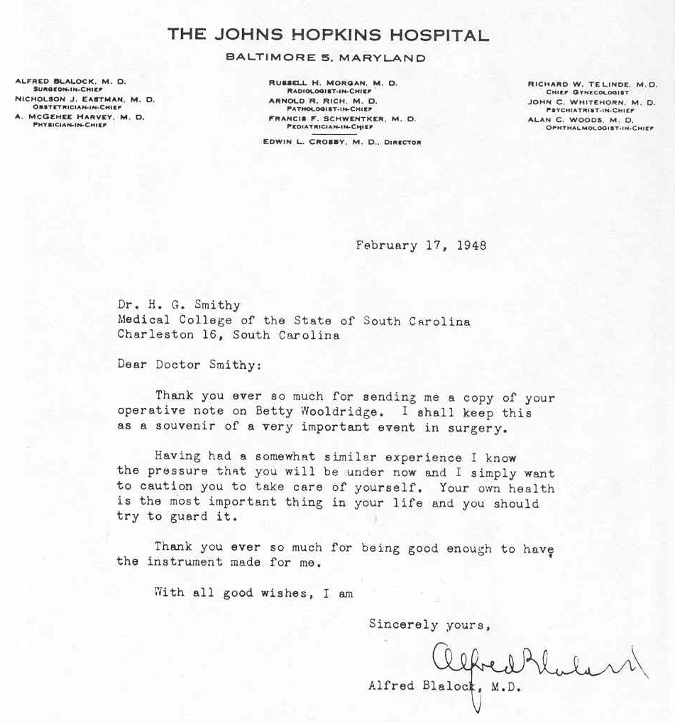

Slide 34
Summary
7 Patients
4/7 No valve tissue removed
2/4 Died (pneumonia, arrhythmia) in hospital
2/4 Survived – no change
3/7 Valve tissue removed
3/3 Survived 6-12 months

Slide 35
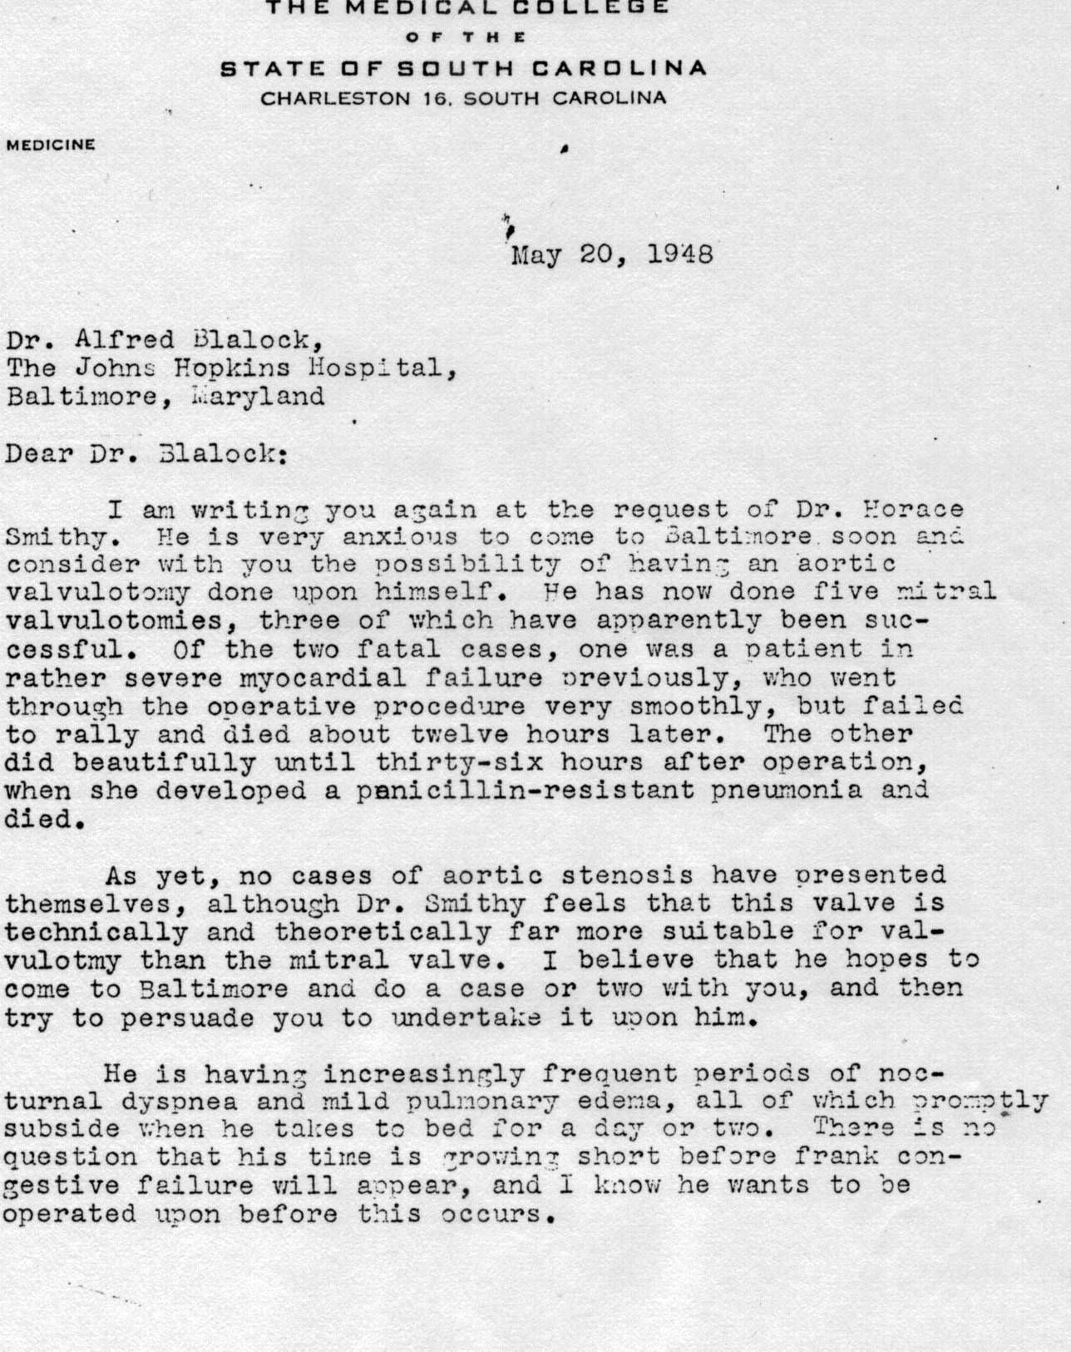
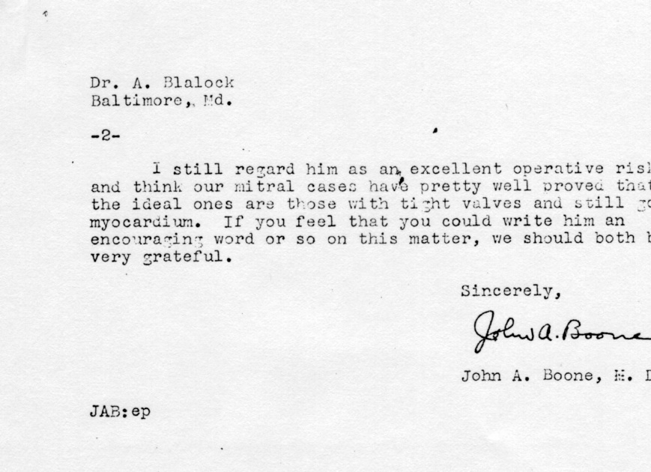
Dr. Boone’s Letter to Dr. Blalock regarding Dr Smithy’s Condition

Slide 36
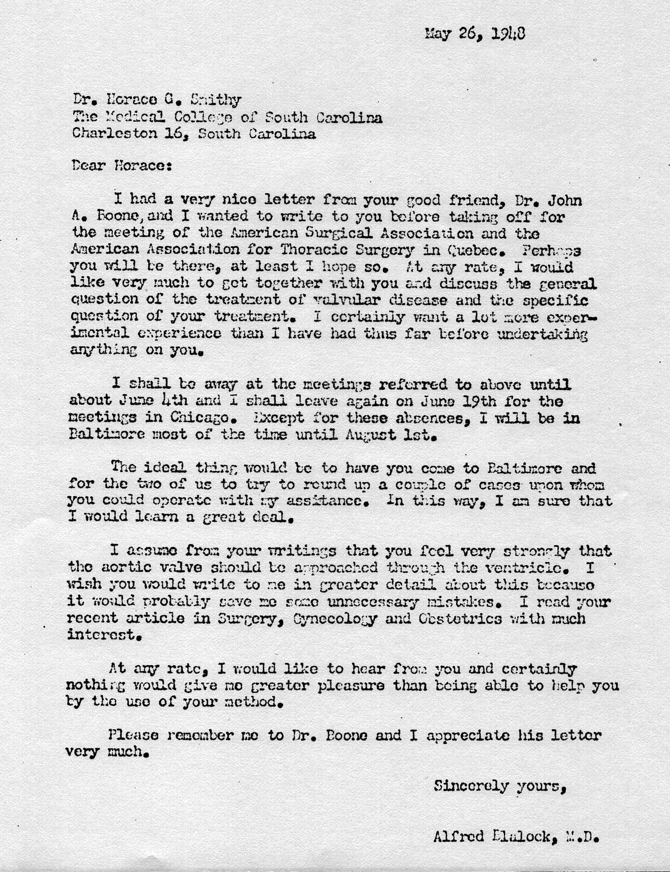
Letter from Dr. Blalock to Horace Smithy after John Boone’s Letter

Slide 37
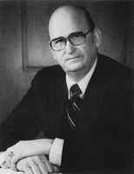
“ Horace got a patient to come from South Carolina to Baltimore to undergo the operation. While Alfred Blalock and Dr. Smithy were scrubbing, the patient
developed an arrhythmia which degenerated into ventricular tachycardia. This was during induction
of anesthesia. Ultimately the patient went into ventricular fibrillation. Dr. Blalock and Smithy opened the patient’s chest, but he could not be
resuscitated. This discouraged Dr. Blalock greatly.”
Interview with Dr. William Muller, 10/18/1991
Randolph Chitwood, M.D.

Slide 38
“Finally the day arrived for the surgery at Hopkins… Anesthesia was started and I made an incision over the fifth intercostal space. Just as I opened the pericardium, the patient developed ventricular fibrillation. Despite all of our efforts to defibrillate and resuscitate, this procedure was not successful. At the time we even used a set of electrodes which I had designed and produced myself for clinical use in the hospital. That was the first defibrillator at the Johns Hopkins Hospital.”
“Horace Smithy was in the operating room at that time, and I looked over at him and saw his face fall. He thought that this was his only chance at having a successful operation for himself.”
Letter, Denton Cooley
September, 2009

Slide 39
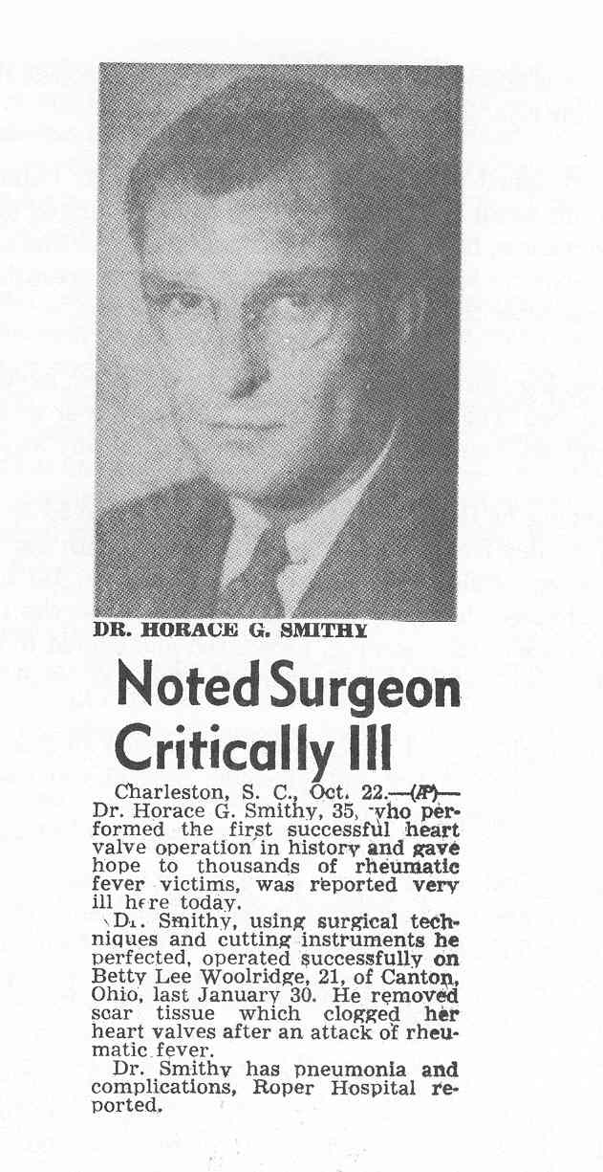

Slide 40
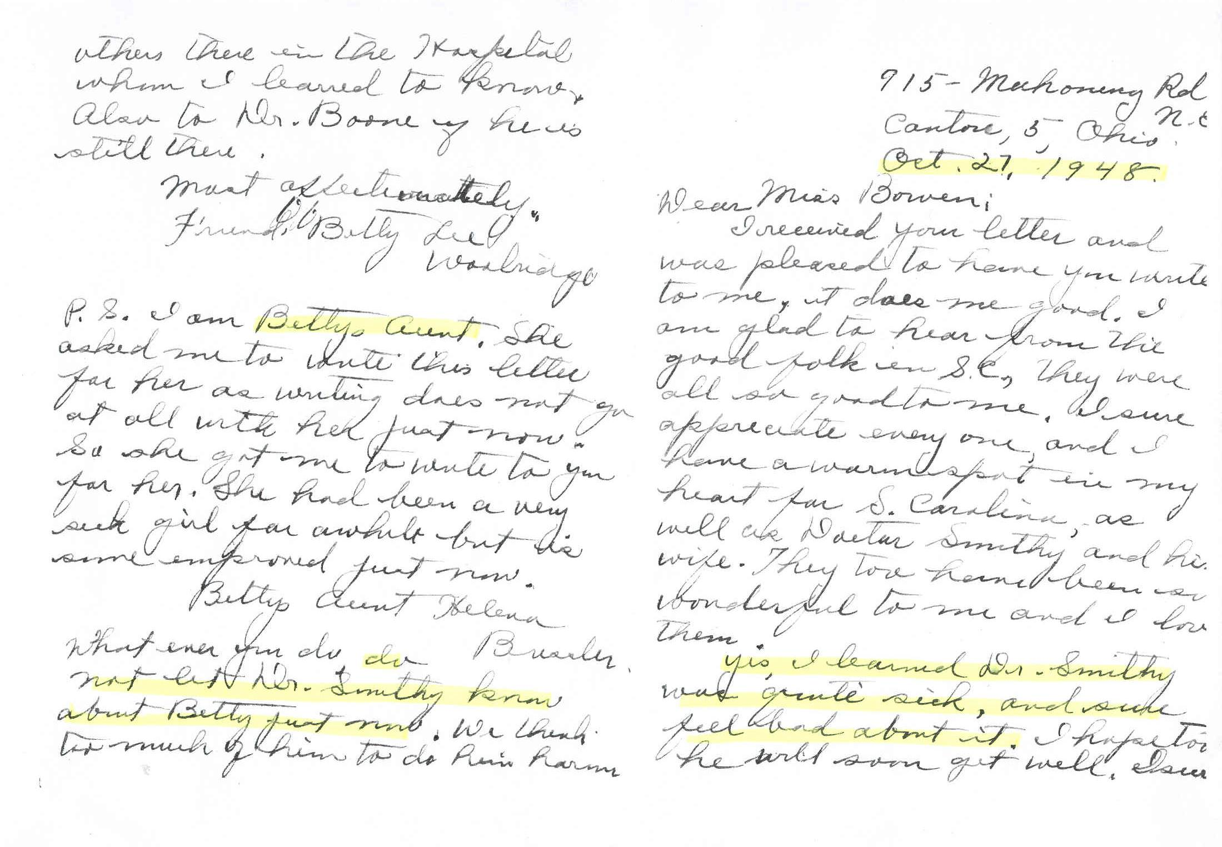

Slide 41
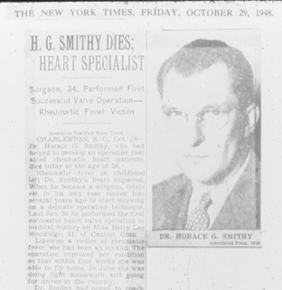
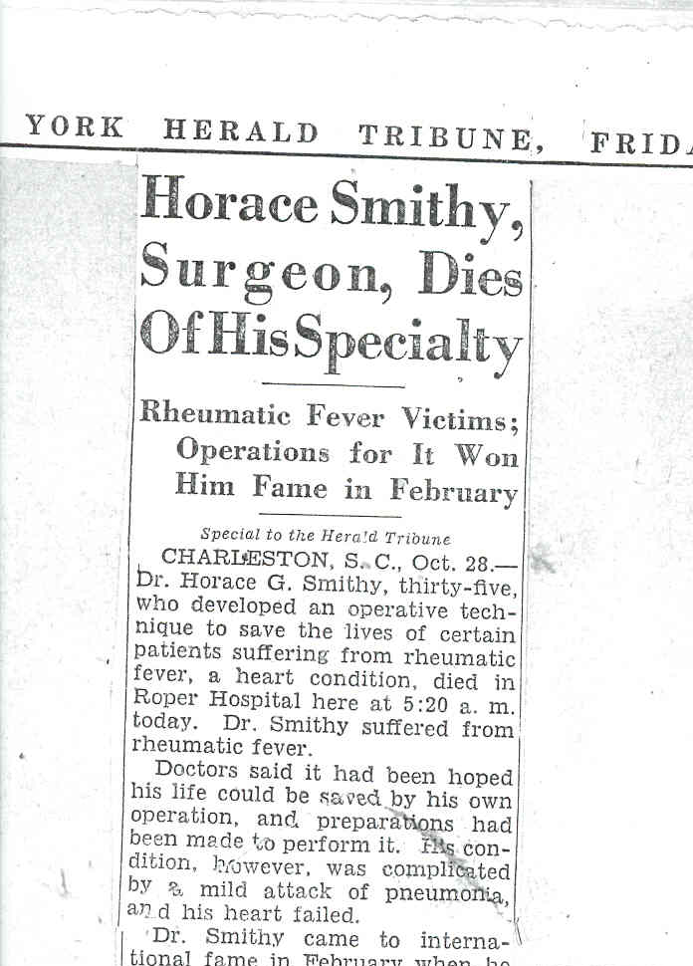
New York Times
New York Herald Tribune

Slide 42
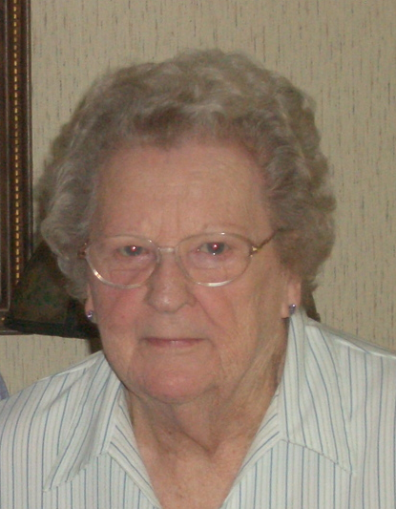
“ Have you heard of the article that he was supposed to give in Miami? Well, he sat up in his bed in the oxygen tent that night and dictated that letter to Dr. Stallworth. He knew that he was going to die. He died at 5:30 the next morning after he finished it.”
Interview with Agnes Kleckley, RN, 8/27/2008
Fred A. Crawford, Jr., M.D.

Slide 43
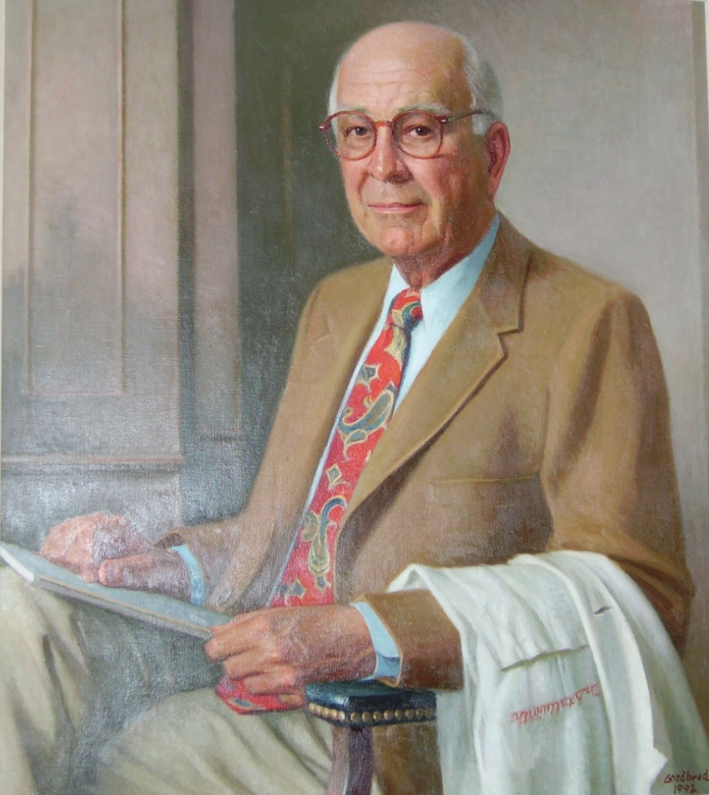
“I left the meeting right after my presentation, as
I was worried about Dr. Smithy’s survival.
Dr. Smithy was very ill but still could talk.
He was very anxious to know how everyone
responded to his work. (Dr. Smithy) had written
part of a paper and wanted me to finish it. After
my discussion (with him) regarding the paper,
he died the next day.”
Interview with Dr. Manley Stallworth,
11/11/1991
Randolph Chitwood, M.D.

Slide 44
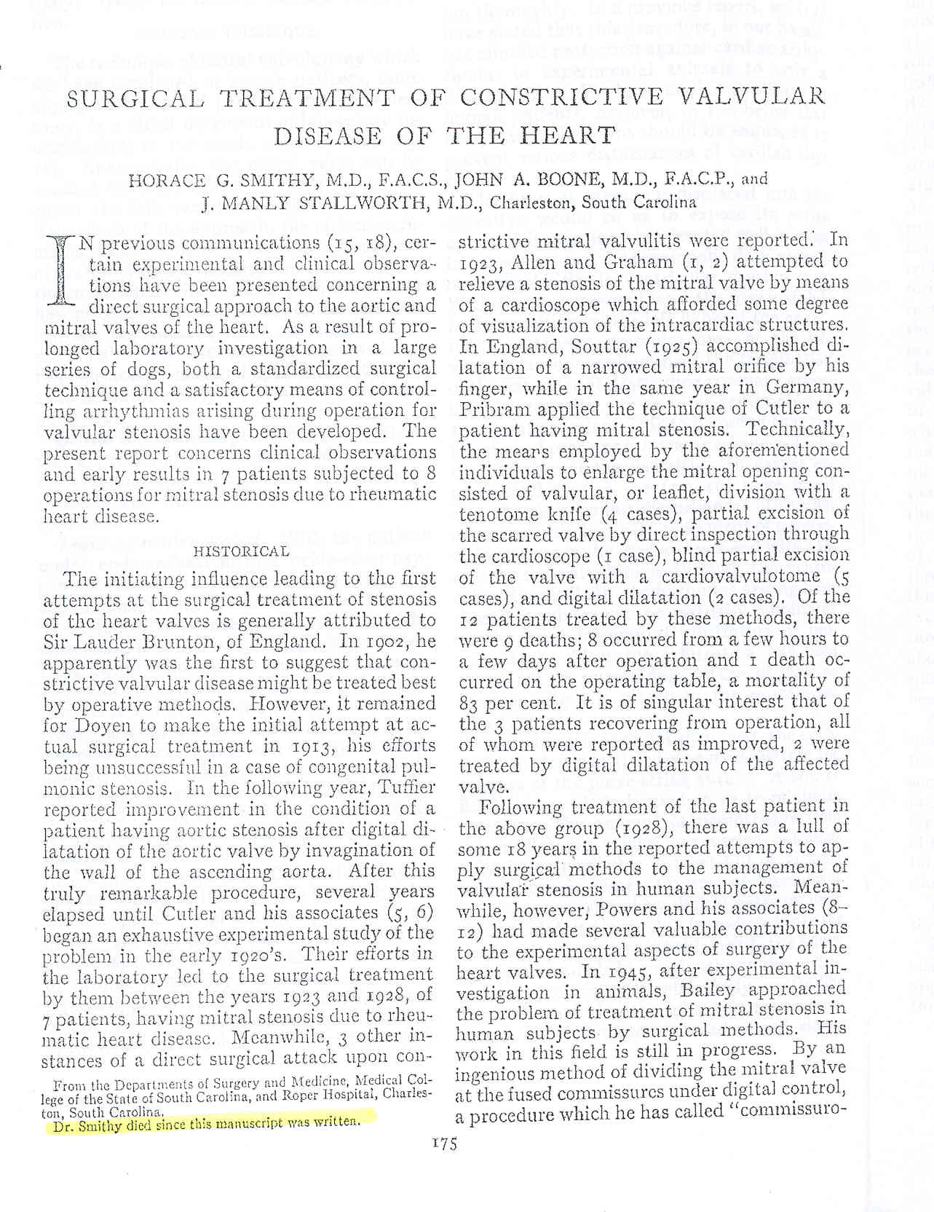

Slide 45
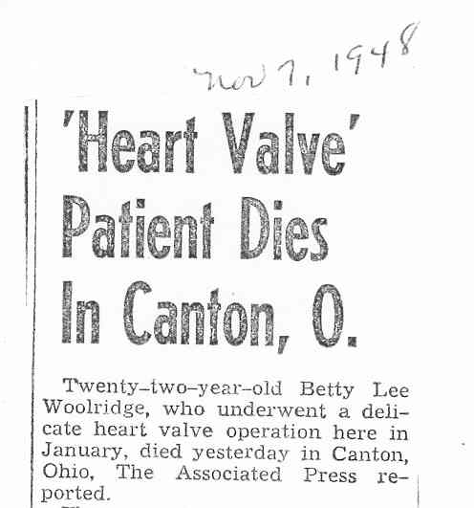

Slide 46
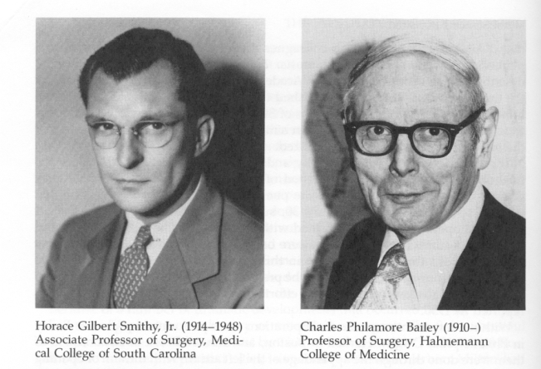
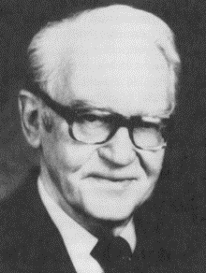
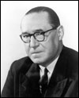
Pioneer Mitral Valve Surgeons
1/30/1948
Horace Smithy, Jr.
6/10/1948
Charles Bailey
6/16/1948
Dwight Harken
9/1948
Lord Russell Brock

Slide 47
